Slide 1



Noida Institute of Engineering and Technology, Greater Noida
Microprocessor
(ACSE0405)
Unit: 3
Code Conversion and BCD Arithmetic
Shikha Singh
Assistant Professor
Department of ECE
B Tech: 4th Sem.

Slide 2

Brief Introduction of Faculty member
Shikha Singh
Assistant Proffesor
Educational Qualification:-M. Tech (VLSI DESIGN)
B. Tech (ECE)
Paper Published: 2 (Conference)
Professional details:
Name of Institute with Code: NIET(133)
Designation: Assistant Professor
Department: ECE
Experience- 4 years

Slide 3

NOIDA INSTITUTE OF ENGINEERING AND TECHNOLOGY, GREATER NOIDA
Evaluation Scheme
Sl. No. | Subject Codes | Subject Name | Periods |  |  | Evaluation Scheme |  |  |  | End Semester |  | Total | Credit
 |  |  | L | T | P | CT | TA | TOTAL | PS | TE | PE
1 | AMIAS0402 | Engineering Mathematics IV | 3 | 1 | 0 | 30 | 20 | 50 |  | 100 |  | 150 | 4
2 | AMIASL0401 | Technical Communication | 2 | 1 | 0 | 30 | 20 | 50 |  | 100 |  | 150 | 3
3 | AMICSE0405 | Microprocessor | 3 | 0 | 0 | 30 | 20 | 50 |  | 100 |  | 150 | 3
4 | AMICSE0403A | Operating Systems | 3 | 0 | 0 | 30 | 20 | 50 |  | 100 |  | 150 | 3
5 | AMICSE0404 | Theory of Automata and Formal Languages | 3 | 0 | 0 | 30 | 20 | 50 |  | 100 |  | 150 | 3
6 | AMICSE0401 | Design and Analysis of Algorithm | 3 | 1 | 0 | 30 | 20 | 50 |  | 100 |  | 150 | 4
7 | AMICSE0455 | Microprocessor Lab | 0 | 0 | 2 |  |  |  | 25 |  | 25 | 50 | 1
8 | AMICSE0453A | Operating Systems Lab | 0 | 0 | 2 |  |  |  | 25 |  | 25 | 50 | 1
9 | AMICSE0451 | Design and Analysis of Algorithm Lab | 0 | 0 | 2 |  |  |  | 25 |  | 25 | 50 | 1
10 | AMICSE0459 | Mini Project using Open Technology | 0 | 0 | 2 |  |  |  | 50 |  |  | 50 | 1
11 | ANC0402 / ANC0401 | Environmental Science*/ Cyber Security*(Non Credit) | 2 | 0 | 0 | 30 | 20 | 50 |  | 50 |  | 100 | 0
 |  | GRAND TOTAL |  |  |  |  |  |  |  |  |  | 1100 | 24

Slide 4
NOIDA INSTITUTE OF ENGINEERING AND TECHNOLOGY, GREATER NOIDA
Course Contents / Syllabus
UNIT-I: 8085 Microprocessor: Introduction to Microprocessor, Microprocessor evolution and types, Microprocessor architecture and its operation, Logic devices for interfacing, Pin diagram and internal architecture of 8085 Microprocessor, Example of an 8085 based computer, Instruction and data flow, timer and timing diagram, interrupt and machine cycle, Addressing modes.
UNIT II : 8085 Instructions and Programming Techniques: Instruction sets, Instruction Classification: data transfer operations, arithmetic operations, logical operations, branching operations, machine control and assembler directives, writing assembly language programs, Programming techniques: looping, counting and indexing.
UNIT III: Code Conversion and BCD Arithmetic: Counter and time delays, Illustrative program: Hexadecimal counter, zero-to-nine, (module ten) counter, generating pulse waveforms, Stack, Subroutine, Restart, Conditional call and return instructions, Advance subroutine concepts, Program: BCD-to-Binary conversion, Binary-to-BCD conversion, BCD-to-Seven segment code converter, Binary-to-ASCII and ASCII-to-Binary code conversion, BCD Addition, BCD Subtraction, Introduction to Advance instructions and Application, Multiplication
UNIT IV: Interfacing of I/O devices: Basic interfacing concepts, Memory interfacing, Interfacing output displays, Interfacing input devices, Memory mapped I/O, Interfacing keyboard and seven segment displays, The 8085 Interrupts, 8085 vector interrupts,8259 programmable interrupt controller.
UNIT-V: Programmable Peripheral IC’s and 8086 Microprocessor: Peripheral Devices: 8255 programmable peripheral interface,8253/8254 programmable timer/counter, 8237 DMA Controller, 8251 USART and RS232C.Introduction to 8086 microprocessors: Architecture of 8086 (Pin diagram, Functional block diagram, register organization), Addressing Modes

Slide 5
NOIDA INSTITUTE OF ENGINEERING AND TECHNOLOGY, GREATER NOIDA
Branch Wise Application
Microprocessor, any of a type of miniature electronic device that contains the arithmetic, logic, and control circuitry necessary to perform the functions of a digital computer’s central processing unit.
This kind of integrated circuit can interpret and execute program instructions as well as handle arithmetic operations.
Microcontroller and Microprocessors are the basic components of Embedded Systems.
Without learning Microprocessors and Microcontrollers, you can not work on Embedded Systems. But also, you should be good in C programming.
You should be good in understanding the documents and write code based on that.

Slide 6
NOIDA INSTITUTE OF ENGINEERING AND TECHNOLOGY, GREATER NOIDA
CONTENT
Course Objective
Unit Objective
Course Outcome
CO and PO Mapping
Topic Objective
Prerequisite
Introduction to Microprocessor
Microprocessor evolution and types
Microprocessor architecture and its operations
Logic devices for interfacing
Pin Diagram
Internal architecture of 8085 Microprocessor
Example of an 8085 based computer
Instruction and data flow
Timer and timing diagram
Interrupt and Machine Cycle
Addressing modes
Daily quiz & MCQs
Old Question Papers
Recap
Video Links
Weekly Assignments
References

Slide 7
NOIDA INSTITUTE OF ENGINEERING AND TECHNOLOGY, GREATER NOIDA
Content
• Introduction to Microprocessor & its application
• Microprocessor evolution and types of microprocessor
• Microprocessor Architecture & operation of its component

Slide 8
NOIDA INSTITUTE OF ENGINEERING AND TECHNOLOGY, GREATER NOIDA
Course Objective
The student should be able to
Understand the functional block diagram and fundamental operation of 8-bit microprocessor(INTEL 8085)
Learn programming skill in assembly language of 8085/86
Understand the knowledge of basic functional operation of 16-bit microprocessor(INTEL 8086)
Acquire basic knowledge of programming and interfacing with peripheral IC’s

Slide 9
NOIDA INSTITUTE OF ENGINEERING AND TECHNOLOGY, GREATER NOIDA
Course Outcome
The student will be able to
Apply a basic concept of digital fundamentals to Microprocessor based personal computer system
Analyze a detailed s/w & h/w structure of the Microprocessor
illustrate how the different peripherals (8085/8086) are interfaced with Microprocessor
Analyze the properties of Microprocessor (8085/8086)
Evaluate the data transfer information through serial and parallel ports

Slide 10
NOIDA INSTITUTE OF ENGINEERING AND TECHNOLOGY, GREATER NOIDA
CO-PO Mapping
 |  |  |  | MICROPROCESSOR(KCS-403)
CO.K | PO1 | PO2 | PO3 | PO4 | PO5 | PO6 | PO7 | PO8 | PO9 | PO10 | PO11 | PO12
AMICSE0405 | 3 | 2 | 2 | 1 | 3 | 2 | 1 | 1 | 3 | 2 | - | 2
AMICSE0405 | 3 | 3 | 3 | 2 | 2 | 2 | 1 | - | 3 | 3 | 2 | 3
AMICSE0405 | 3 | 3 | 3 | 3 | 3 | 1 | 1 | - | 2 | 3 | 2 | 2
AMICSE0405 | 3 | 3 | 3 | 3 | 3 | 3 | 3 | 3 | 3 | 2 | 3 | 2
AMICSE0405 | 3 | 3 | 3 | 3 | 3 | 3 | - | 3 | 3 | 1 | 2 | 2
Avg. | 3 | 2.8 | 2.8 | 1.4 | 2.8 | 2.2 | 1.5 | 2.3 | 2.8 | 2.2 | 2.2 | 2.2

Slide 11
NOIDA INSTITUTE OF ENGINEERING AND TECHNOLOGY, GREATER NOIDA
CO-PSO Mapping
MICROPROCESSOR (KCS-403)
CO.K | PSO1 | PSO2 | PSO3 | PSO4
KCS-403. 1 | 3 | 3 | 3 | 2
KCS-403. 2 | 2 | 2 | 2 | 1
KCS-403.3 | 3 | 3 | 3 | 2
KCS-403. 4 | 2 | 3 | 3 | 2
KCS-403. 5 | 2 | 3 | 3 | 1
Average | 2.4 | 2.8 | 2.8 | 1.6

Slide 12
NOIDA INSTITUTE OF ENGINEERING AND TECHNOLOGY, GREATER NOIDA
Unit Objective
To study the Counter and time delays.
To acquire the concept of programming for counter.
To understand the concept of BCD Addition & Subtraction.
To learn conversion Binary-to-BCD conversion etc.
To discuss concept of Stack, Subroutine, Restart, Conditional call and return instruction.
To acquire the knowledge of Advance Instruction and Application, Multiplication.

Slide 13
NOIDA INSTITUTE OF ENGINEERING AND TECHNOLOGY, GREATER NOIDA
End Semester Question Paper Template
B.Tech (Semester IV Theory Examination 2021-22) Total Marks : 100
Note: Attempt all sections. If require any missing data, then choose suitably. Time: 3 hours
Section A
1. Attempt all questions in brief. 2 X 10 = 20
Q. No. | Question | Marks | CO
a. to j |  | 2
Section B
2. Attempt any three of the following 3 X 10 = 30
Q. No. | Question | Marks | CO
a to e |  | 10
Section C
Question no. 3,4,5,6,7. Attempt any one of the following 1 X 10 = 10
a |  | 10
b |  | 10

Slide 14
NOIDA INSTITUTE OF ENGINEERING AND TECHNOLOGY, GREATER NOIDA
Topic-1 Objective
Name of the Topic | Objective of the topic | Mapping with CO
Counter and Time Delays | To understand the concept of microprocessor. | CO1

Slide 15
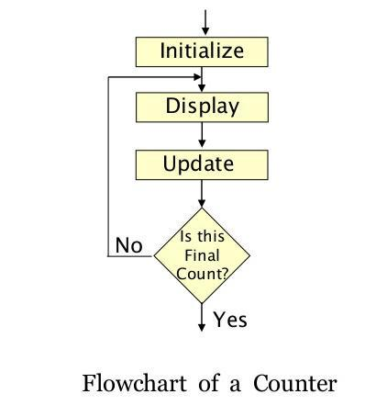
NOIDA INSTITUTE OF ENGINEERING AND TECHNOLOGY, GREATER NOIDA
Counter and Time Delays
A loop counter is set up by loading a register with a certain value.
Then using the DCR (to decrement) and INR (to increment) the contents of the register are updated.
A loop is set up with a conditional jump instruction that loops back or depending on whether the count has reached the termination count.
The operation of a loop counter can be described using the following flowchart.

Slide 16
NOIDA INSTITUTE OF ENGINEERING AND TECHNOLOGY, GREATER NOIDA
Counter and Time Delays
Using DCR instruction
MVI C, 15H
LOOP DCR C
JNZ LOOP

Slide 17
NOIDA INSTITUTE OF ENGINEERING AND TECHNOLOGY, GREATER NOIDA
TIME DELAY
Why Time delays?
In the real time applications, such as traffic light control, digital clock, process control, serial communication, it is important to keep a track with time. For example in traffic light control application, it is necessary to give time delays between two transitions. These time delays are in few seconds and can be generated with the help of executing group of instructions number of times. These software timers are also called time delays or software delays.
As you know microprocessor system consists of two basic components, Hardware and software. The software component controls and operates the hardware to get the desired output with the help of instructions. To execute these instructions, microprocessor takes fix time as per the instruction, since it is driven by constant frequency clock. This makes it possible to introduce delay for specific time between two events.

Slide 18
NOIDA INSTITUTE OF ENGINEERING AND TECHNOLOGY, GREATER NOIDA
TIME DELAY
The procedure used to design a specific delay is similar to that used to set up a counter.
A register is loaded with a number, depending on the time delay required, and then the register is decremented until it reaches zero by setting up a loop with conditional jump instruction. The loop causes a delay, depending upon the clock period of the system.
We can design time delay using following three techniques:
Time delay using one register
Time delay using register pair
Time delay using a loop within a loop

Slide 19
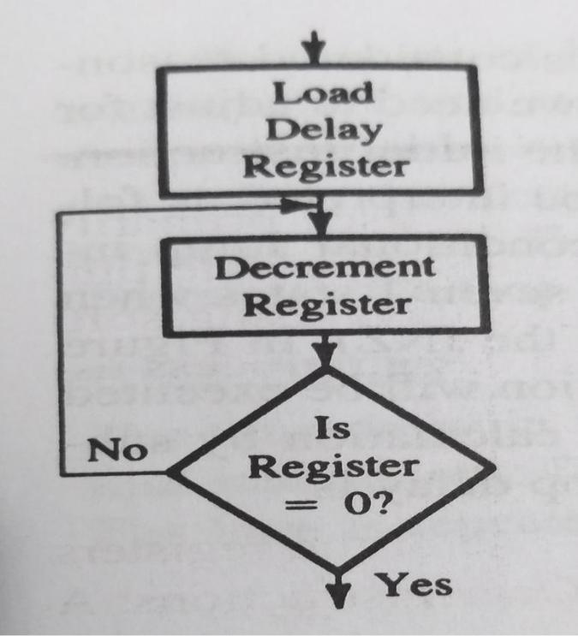
NOIDA INSTITUTE OF ENGINEERING AND TECHNOLOGY, GREATER NOIDA
Time delay using one register
A count is loaded in a register and the loop is executed until the count reaches to zero. The flowchart has been shown below:

Slide 20
NOIDA INSTITUTE OF ENGINEERING AND TECHNOLOGY, GREATER NOIDA
Time delay Formulas
Total delay T_{D} = Time to execute instructions outside loop (T_{O}) + Time to execute loop instructions (T_{L})
Time required to execute an instruction= number of T-states* clock period
Clock frequency of the system f
Clock period T= 1/f
Time Delay in Loop T_{L}= T*Loop T states * N10
N10 = Equivalent decimal number of hexadecimal count loaded in the delay register

Slide 21
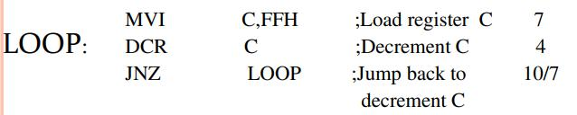
NOIDA INSTITUTE OF ENGINEERING AND TECHNOLOGY, GREATER NOIDA
Example:
Label opcode operand Description T-state
Clock frequency of the system f = 2 MHz
Clock period= 1/f= 1/2 = 0.5 μs
Time to execute MVI = T-state for MVI*clock period
T_{O} =7 T states * 0.5
= 3.5 μs
Time Delay in Loop T_{L}= T*Loop T states * N₁₀
0.5 * 14* 255
1785 μs
1.8 ms

Slide 22
NOIDA INSTITUTE OF ENGINEERING AND TECHNOLOGY, GREATER NOIDA
Note: 255 is equivalent decimal number of hexadecimal count FF loaded in the register C.
Note: T-states for JNZ instruction are shown as 10/7. The 8085 microprocessor requires 10 T-states to execute a conditional jump when it jumps and seven T-states when in the last iteration, JNZ will fail (C reaches to zero).
The adjusted loop delay T_{LA}= Time to execute loop instructions =
T_{L} – (3T states* clock period)
=1785- 3*.5
=1785-1.5
=1783.5 μs
Note: The difference between loop delay and adjusted loop delay is approax 2 μs Hence it can be ignored in some cases.
Total delay T_{D} = Time to execute instructions outside loop (T_{O}) + Time to execute loop instructions (T_{L})
T_{O}+T_{LA}
3.5+1783.5 =1787 μs

Slide 23
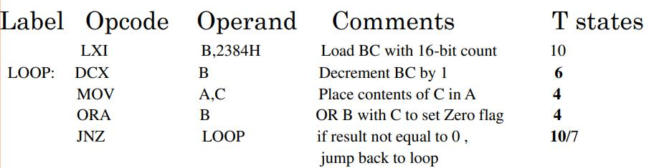
NOIDA INSTITUTE OF ENGINEERING AND TECHNOLOGY, GREATER NOIDA
TIME DELAY USING A REGISTER PAIR
The time delay can be increased by setting a loop and using a register pair with a 16-bit number (maximum FFFF H). The 16-bit number is decremented using DCX instruction. However the, instruction DCX does not set the zero flag. So, additional techniques must be used to set the zero flag.
Example:

Slide 24
NOIDA INSTITUTE OF ENGINEERING AND TECHNOLOGY, GREATER NOIDA
TIME DELAY USING A REGISTER PAIR
Example:
Clock frequency of the system f = 2 MHz Clock period= 1/f= 1/2 = 0.5 μs Decimal equivalent of 2384 H = 9092₁₀
Time to execute LXI = T-state for LXI*clock period
T_{O} =10T states * 0.5
=5 μs
Time Delay in Loop T_{L}= T*Loop T states * N₁₀ =0.5*24*9092
=109104 μs
=109 ms

Slide 25
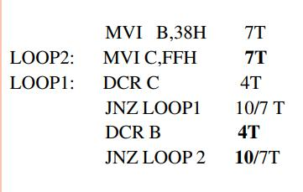
NOIDA INSTITUTE OF ENGINEERING AND TECHNOLOGY, GREATER NOIDA
Time delay using a loop within a loop
Example: Time Delay using a LOOP within a LOOP
Delay in Loop T_{L1}=1783.5 μs
56 is the decimal equivalent of 38 hexadecimal value.
Delay in Loop T_{L2}= (0.5*21+T_{L1})*56
100.46ms
Timer Delay Using NOP Instruction:
NOP instruction does nothing but takes 4T states of processor time to execute. So by executing NOP instruction in between two instructions we can get delay of 4 T-state

Slide 26
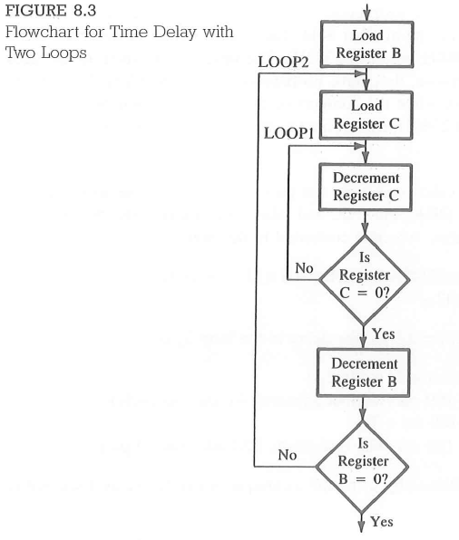
NOIDA INSTITUTE OF ENGINEERING AND TECHNOLOGY, GREATER NOIDA

Slide 27
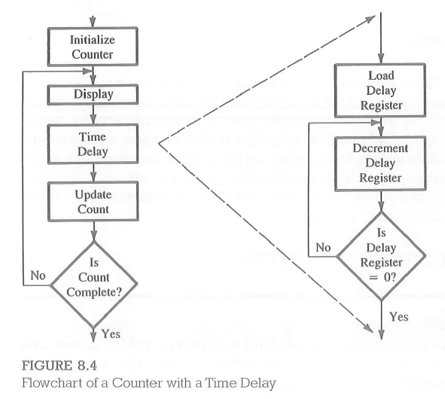
NOIDA INSTITUTE OF ENGINEERING AND TECHNOLOGY, GREATER NOIDA
Counter design with time delay

Slide 28
NOIDA INSTITUTE OF ENGINEERING AND TECHNOLOGY, GREATER NOIDA
Topic-2 Objective
Name of the Topic | Objective of the topic | Mapping with CO
Illustrative program: Hexadecimal counter | To understand the concept of Illustrative program: Hexadecimal counter | CO1

Slide 29
NOIDA INSTITUTE OF ENGINEERING AND TECHNOLOGY, GREATER NOIDA
Hexadecimal Counter
Program Statement: Write a program to count continuously in hexadecimal from FFH to 00H in a system with clock period 0.5 microseconds. Use register C to set up a delay of 1ms between each count and display output at one of the output ports.
Problem Analysis: 1. The hexadecimal counter is set by loading a register with starting number and decrementing it till zero is reached and then again decrementing it to will produce -1, which is two’s complement of FFH. Hence, the register again reaches FFH.
2. The 1ms time delay is set up by the procedure shown in flowchart- The register is loaded with appropriate number such that the execution of above loop produces a time delay of 1ms.

Slide 30
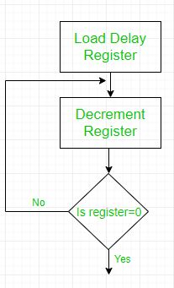
NOIDA INSTITUTE OF ENGINEERING AND TECHNOLOGY, GREATER NOIDA
Hexadecimal Counter
Program Statement:
Address Label Mnemonics
2000H MVI B, FFH
2002H NEXT DCR B
2003H MVI C, COUNT
2005H DELAY DCR C
2006H JNZ DELAY
2009H MOV A, B
200AH OUTPORT#
200CH JMP NEXT

Slide 31
NOIDA INSTITUTE OF ENGINEERING AND TECHNOLOGY, GREATER NOIDA
Hexadecimal Counter
The C register is the time delay register which is loaded by a value COUNT to produce a time delay of 1ms.
To find the value of COUNT we do-
T_{D} = T_{L} + T_{O}
Where- TD = Time Delay, TL = Time delay inside loop, TO = Time delay outside loop
The delay loop includes two instructions-
DCR C (4 T-states) and JNZ (10 T-states)
So, TL = 14*Clock period*COUNT
=> 14*(0.5*10-6)*COUNT
=> (7*10-6)*COUNT
Delay outside the loop includes-
DCR B : 4T
MVI C, COUNT : 7T
MOV A, B : 4T
OUTPORT : 10T
JMP : 10T
Total : 35T
TO = 35*Clock period => 17.5 microseconds
So,
1ms= (17.5+ 7*COUNT)microsecond
Therefore, COUNT=(140)10

Slide 32
NOIDA INSTITUTE OF ENGINEERING AND TECHNOLOGY, GREATER NOIDA
Illustrative program: Zero-to-nine, (module ten)
Program Statement: Write a program to count from 0 to 9 with a one-second delay between each count. At the count of 9, the counter should reset itself to 0 and repeat the sequence continuously. Use register pair HL to set up the delay and display each count at one of the output ports. Assume the clock frequency of the microcomputer is 1 MHz.
Instructions: Review the following Instructions:
LXI: Load Register Pair Immediate
DCX: Decrement Register Pair
INX: Increment Register Pair
These instructions manipulate 16-bit data by using registers in pairs (BC. DE. and HL). However, the instructions DCX and INX do not set flags to reflect the outcome of the operation. Therefore, additional instructions must be used to set the flags.
Problem Analysis: 1.

Slide 33
NOIDA INSTITUTE OF ENGINEERING AND TECHNOLOGY, GREATER NOIDA
Illustrative program: Zero-to-nine, (module ten)
Problem Analysis: The problem is similar to that in the Illustrative Program for a hexadecimal counter except in two respects: the counter is an up-counter (counts up to the digit 9), and the delay is too long to use just one register.
The counter is set up by loading a register with the appropriate number and in crementing it until reaches the digit 9. When the counter register reaches the final count, it is reset to zero.
The 1-second delay between each count is set up by using a register pair.

Slide 34
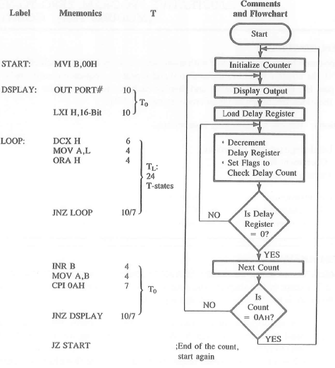
NOIDA INSTITUTE OF ENGINEERING AND TECHNOLOGY, GREATER NOIDA
Illustrative program: Zero-to-nine, (module ten)

Slide 35
NOIDA INSTITUTE OF ENGINEERING AND TECHNOLOGY, GREATER NOIDA
Illustrative program: Zero-to-nine, (module ten)
Delay Calculations: The major delay between two counts is provided by the 16-bit number in the delay register HL. (the inner loop in the flowchart). This delay is set up by using a register pair, Loop Delay TL = 24 T-states x Tx Count
1 second = 24 x 1.0 x 10^-6 x Count
Count = 1/ 24 × 10^6 = 41666 = A2C2H
The delay count A2C2H in register HL would provide approximately a 1-second delay between two counts. To achieve higher accuracy in the delay, the instructions outside the loop starting from OUT PORT# to JNZ DSPLAY must be accounted for in the delay calculations.
The instructions outside the loop are: OUT, LXI, INR, MOV, CPI, and INZ (DSPLAY). These instructions require 47 T-states; therefore, the delay count is calculated as follows:
Total Delay TD = To + TL
1 second = (47 x 1.0 × 10^-6 ) + (24 x 1.0 x 10^-6 x Count)
Count = 41664

Slide 36
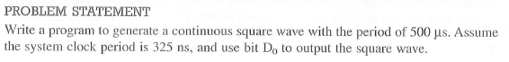
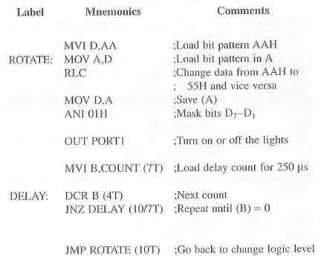
NOIDA INSTITUTE OF ENGINEERING AND TECHNOLOGY, GREATER NOIDA
Illustrative program: Generating Pulse Waveform

Slide 37
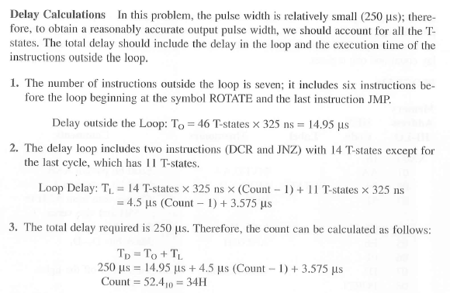
NOIDA INSTITUTE OF ENGINEERING AND TECHNOLOGY, GREATER NOIDA
Illustrative program: Generating Pulse Waveform

Slide 38
NOIDA INSTITUTE OF ENGINEERING AND TECHNOLOGY, GREATER NOIDA
Topic-3 Objective
Name of the Topic | Objective of the topic | Mapping with CO
Stack | To understand the concept of Stack | CO1

Slide 39
NOIDA INSTITUTE OF ENGINEERING AND TECHNOLOGY, GREATER NOIDA
Stack
The stack is an area of memory identified by the programmer for temporary storage of information.
The stack is a LIFO structure- Last In First Out.
The stack normally grows backwards into memory.
In other words, the programmer defines the bottom of the stack, and the stack grows up into reducing address range.
Memory
The Stack grows backwards into memory
Bottom of the Stack

Slide 40
NOIDA INSTITUTE OF ENGINEERING AND TECHNOLOGY, GREATER NOIDA
Stack
In the 8085, the stack is defined by setting the SP (Stack Pointer) register.
LXI SP, FFFFH
This sets the Stack Pointer to location FFFFH (end of memory for the 8085).
The Size of the stack is limited only by the available memory
Information is saved on the stack by PUSHing it on.
It is retrieved from the stack by POPing it off.
The 8085 provides two instructions: PUSH and POP for storing information on the stack and retrieving it back.
– Both PUSH and POP work with register pairs ONLY.

Slide 41
NOIDA INSTITUTE OF ENGINEERING AND TECHNOLOGY, GREATER NOIDA
Stack
The PUSH Instruction
PUSH B (1 Byte Instruction)
Decrement SP
Copy the contents of register B to the memory location pointed to by SP
Decrement SP
Copy the contents of register C to the memory location pointed to by SP
B C
12
F3
F3
12
FFFB FFFC FFFD FFFE FFFF
SP

Slide 42
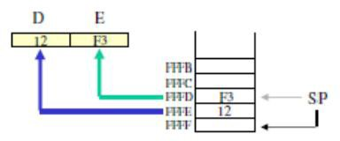
NOIDA INSTITUTE OF ENGINEERING AND TECHNOLOGY, GREATER NOIDA
Stack
The POP Instruction
POP D (1 Byte Instruction)
Copy the contents of the memory location pointed to by the SP to register E
Increment SP
Copy the contents of the memory location pointed to by the SP to register D
Increment SP

Slide 43
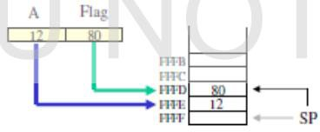
NOIDA INSTITUTE OF ENGINEERING AND TECHNOLOGY, GREATER NOIDA
Stack
PUSH PSW Register Pair
This register pair is made up of the Accumulator and the Flags registers. PUSH PSW (1 Byte Instruction)
Decrement SP
Copy the contents of register A to the memory location pointed to by SP
Decrement SP
Copy the contents of Flag register to the memory location pointed to by SP

Slide 44
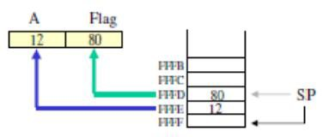
NOIDA INSTITUTE OF ENGINEERING AND TECHNOLOGY, GREATER NOIDA
Stack
POP PSW (1 Byte Instruction)
Copy the contents of the memory location pointed to by the SP to Flag register
Increment SP
Copy the contents of the memory location pointed to by the SP to register A
Increment SP

Slide 45
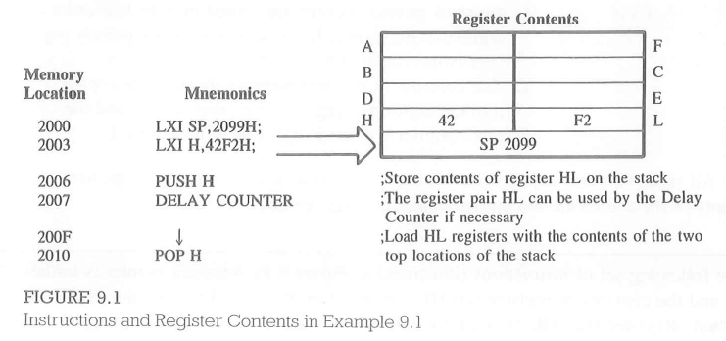
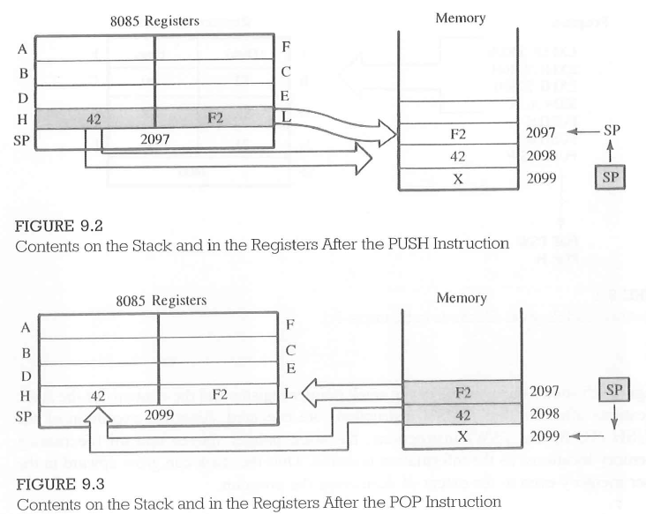
NOIDA INSTITUTE OF ENGINEERING AND TECHNOLOGY, GREATER NOIDA
Stack

Slide 46
NOIDA INSTITUTE OF ENGINEERING AND TECHNOLOGY, GREATER NOIDA
Topic-4 Objective
Name of the Topic | Objective of the topic | Mapping with CO
Subroutine | To understand the concept of Subroutine | CO1

Slide 47
NOIDA INSTITUTE OF ENGINEERING AND TECHNOLOGY, GREATER NOIDA
Subroutine
A subroutine is a group of instructions (subprogram) that will be used repeatedly in different locations of the program.
Rather than repeat the same instructions several times, they can be grouped into a subroutine that is called from the different locations.
In Assembly language, a subroutine can exist anywhere in the code.
However, it is customary to place subroutines separately from the main program.
The 8085 has two instructions for dealing with subroutines.
The CALL instruction is used to redirect program execution to the subroutine.
The RET instruction is used to return the execution to the calling routine.

Slide 48
NOIDA INSTITUTE OF ENGINEERING AND TECHNOLOGY, GREATER NOIDA
Subroutine
A subroutine is a group of instructions (subprogram) that will be used repeatedly in different locations of the program.
Rather than repeat the same instructions several times, they can be grouped into a subroutine that is called from the different locations.
In Assembly language, a subroutine can exist anywhere in the code.
However, it is customary to place subroutines separately from the main program.
The 8085 has two instructions for dealing with subroutines.
The CALL instruction is used to redirect program execution to the subroutine.
The RET instruction is used to return the execution to the calling routine.

Slide 49
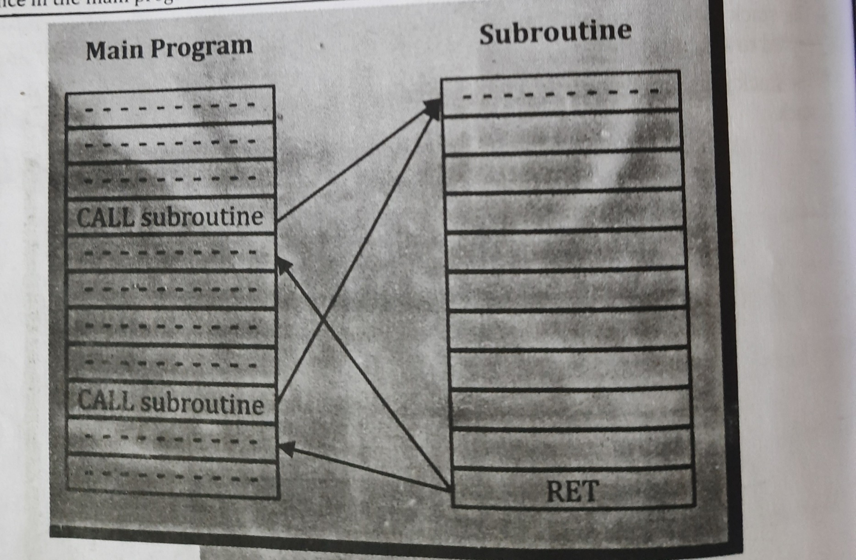
NOIDA INSTITUTE OF ENGINEERING AND TECHNOLOGY, GREATER NOIDA
Subroutine

Slide 50
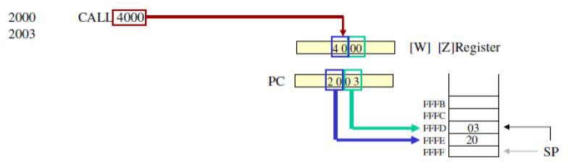
NOIDA INSTITUTE OF ENGINEERING AND TECHNOLOGY, GREATER NOIDA
Subroutine
The CALL Instruction:
CALL 4000H (3-byte instruction)
– When CALL instruction is fetched, the Microprocessor knows that the next two Memory locations contain 16-bit subroutine address in the memory.

Slide 51
NOIDA INSTITUTE OF ENGINEERING AND TECHNOLOGY, GREATER NOIDA
Subroutine
The CALL Instruction:
CALL 4000H (3-byte instruction)
– When CALL instruction is fetched, the Microprocessor knows that the next two Memory locations contain 16-bit subroutine address in the memory.

Slide 52
NOIDA INSTITUTE OF ENGINEERING AND TECHNOLOGY, GREATER NOIDA
Subroutine
Microprocessor reads the subroutine address from the next two memory location and stores the higher order 8bit of the address in the W register and stores the lower order 8bit of the address in the Z register.
Pushes the current value of Program Counter onto the stack [Return address]
Loads the program counter with the 16‐bit address supplied with the CALL instruction from WZ register.
RET (1 byte instruction)
Retrieve the return address from the top of the stack
Load the program counter with the return address.

Slide 53
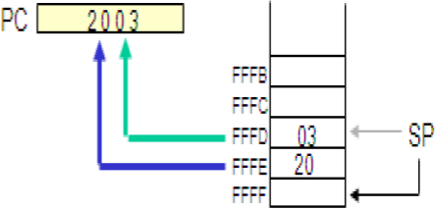
NOIDA INSTITUTE OF ENGINEERING AND TECHNOLOGY, GREATER NOIDA
Subroutine
RET (1 byte instruction)
Retrieve the return address from the top of the stack
Load the program counter with the return address.

Slide 54
NOIDA INSTITUTE OF ENGINEERING AND TECHNOLOGY, GREATER NOIDA
Subroutine
Conditional CALL and RET Instructions:
The conditional call and the return instructions are based on four data conditions (flags)-carry, zero, sign and parity.
The conditions are tested by checking the respective flags.
In case of a conditional call instruction, the program is transferred to the subroutine if condition is met; otherwise, the main program is continued.
In case of a conditional return instruction, the sequence returns to the main program if the condition is met; otherwise, the sequence in the subroutine is continued.

Slide 55
NOIDA INSTITUTE OF ENGINEERING AND TECHNOLOGY, GREATER NOIDA
Subroutine
The 8085 supports conditional CALL and conditional RET instructions.
Conditional CALL:
CC, calls subroutine if Carry flag is set.
CNC, call subroutine if Carry flag is not set
CZ, calls subroutine if zero flag is set.
CNZ, call subroutine if zero flag is not set
CM, calls subroutine if sign flag is set. (sign=1 negative number)
CP, call subroutine if sign flag is not set (sign =0 positive number)
CPE, call subroutine if Parity flag is set (P=1, even parity)
CPO, call subroutine if Parity flag is reset (P=0, odd parity)

Slide 56
NOIDA INSTITUTE OF ENGINEERING AND TECHNOLOGY, GREATER NOIDA
Subroutine
Conditional Return:
RC, returns from subroutine if Carry flag is set
RNC, returns from subroutine if Carry flag is not set etc
RZ, returns subroutine if zero flag is set.
RNZ, returns subroutine if zero flag is not set
RM, returns subroutine if sign flag is set. (Sign=1 negative number)
RP, returns subroutine if sign flag is not set. (sign =0 positive number)
–RPE, returns subroutine if parity flag is set. (P=1 even parity)
–RPO, returns subroutine if parity flag is not set. (P=0 odd parity)

Slide 57
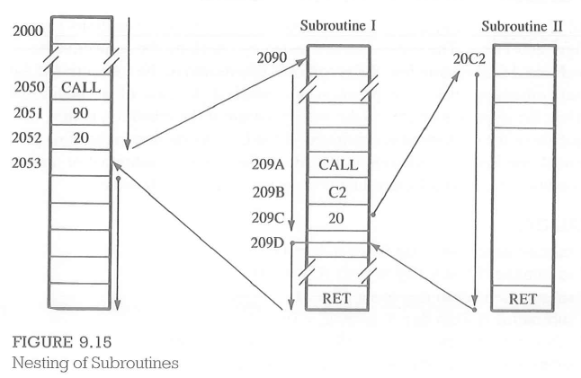
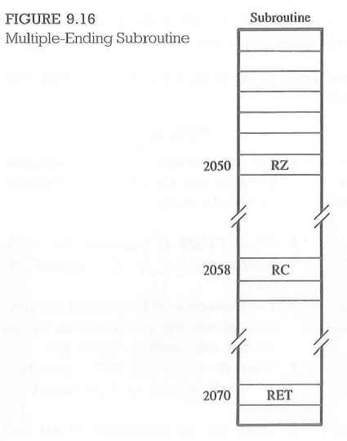
Advanced Subroutine Concepts

Slide 58
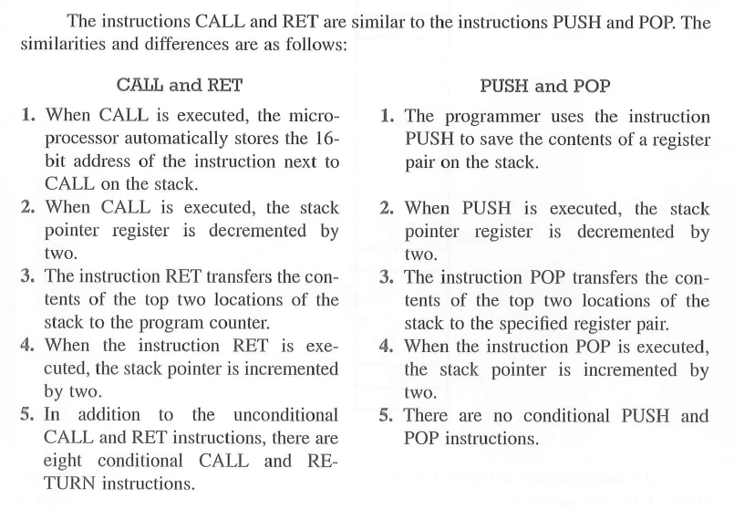
NOIDA INSTITUTE OF ENGINEERING AND TECHNOLOGY, GREATER NOIDA
Subroutine

Slide 59
NOIDA INSTITUTE OF ENGINEERING AND TECHNOLOGY, GREATER NOIDA
Topic-5 Objective
Name of the Topic | Objective of the topic | Mapping with CO
Code Conversion | To understand the concept of Code Conversion | CO1

Slide 60
NOIDA INSTITUTE OF ENGINEERING AND TECHNOLOGY, GREATER NOIDA
Code Conversion
The ASCII (American Standard Code For Information Interchange) keyboard is a commonly used input device for disk-based microcomputer systems.
Alphanumeric characters (letters and numbers) are displayed on a CRT (cathode ray tube) terminal using the ASCII code. However, inside the microprocessor data processing is usually performed in binary.
In some instances, arithmetic operations are performed in BCD numbers. Therefore, data must be converted from one code to another code.
The programming techniques used for code conversion fall into four general categories:
Conversion based on the position of a digit in a number (BCD to binary and vice versa).
Conversion based on hardware consideration (binary to seven-segment code using table look- up procedure).
Conversion based on sequential order of digits (binary to ASCII and vice versa).
Decimal adjustment in BCD arithmetic operations. (This is an adjustment rather than a code conversion.)

Slide 61
NOIDA INSTITUTE OF ENGINEERING AND TECHNOLOGY, GREATER NOIDA
BCD To Binary Conversion
In most microprocessor-based products, data are and displayed in decimal numbers.
The system-monitor program of instrument converts each key into an equivalent 4-bit number, stores two numbers an Two BCD numbers in an 8-bit register memory location. These numbers called packed BCD.
Even if data are entered in decimal digits, it is inefficient to process data in BCD numbers because, in each 4-bit combination, digits A through F go unused. Therefore, BCD numbers are converted into binary numbers for data processing.
The conversion of BCD number into its binary equivalent employs the principle positional weighting in a given number.

Slide 62
NOIDA INSTITUTE OF ENGINEERING AND TECHNOLOGY, GREATER NOIDA
BCD To Binary Conversion
For example: 7210 = 7 × 10 + 2
The digit 7 represents 70, based on its second position the right. Therefore, converting 72BCD into its binary equivalent requires multiplying second digit 10, and adding digit.
Converting 2-digit BCD number into binary equivalent the following steps:
Separate an 8-bit packed BCD number into 4-bit unpacked digits: BCD1, and BCD₂.
Convert each digit into its binary value according to its position.
Add both binary numbers to obtain the binary equivalent of the BCD numbers.

Slide 63
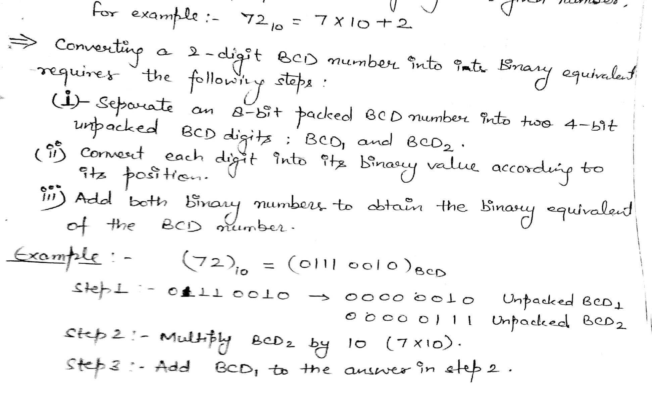
NOIDA INSTITUTE OF ENGINEERING AND TECHNOLOGY, GREATER NOIDA
BCD To Binary Conversion

Slide 64
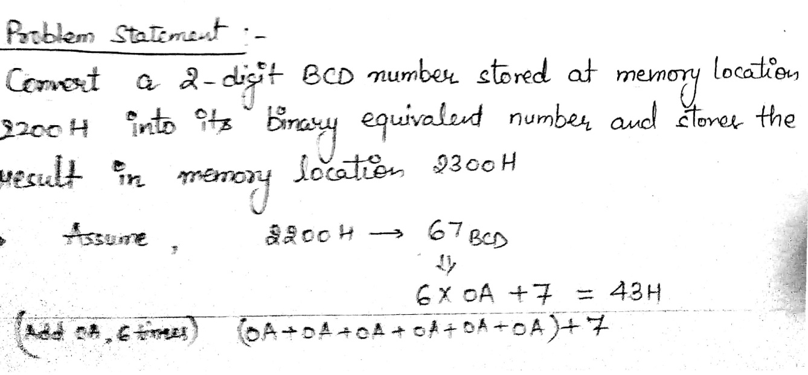
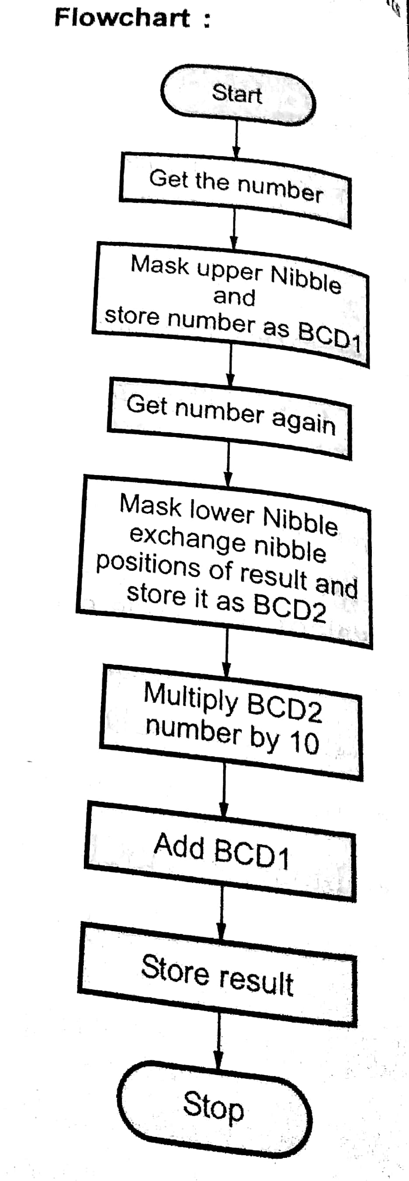
NOIDA INSTITUTE OF ENGINEERING AND TECHNOLOGY, GREATER NOIDA
BCD To Binary Conversion

Slide 65
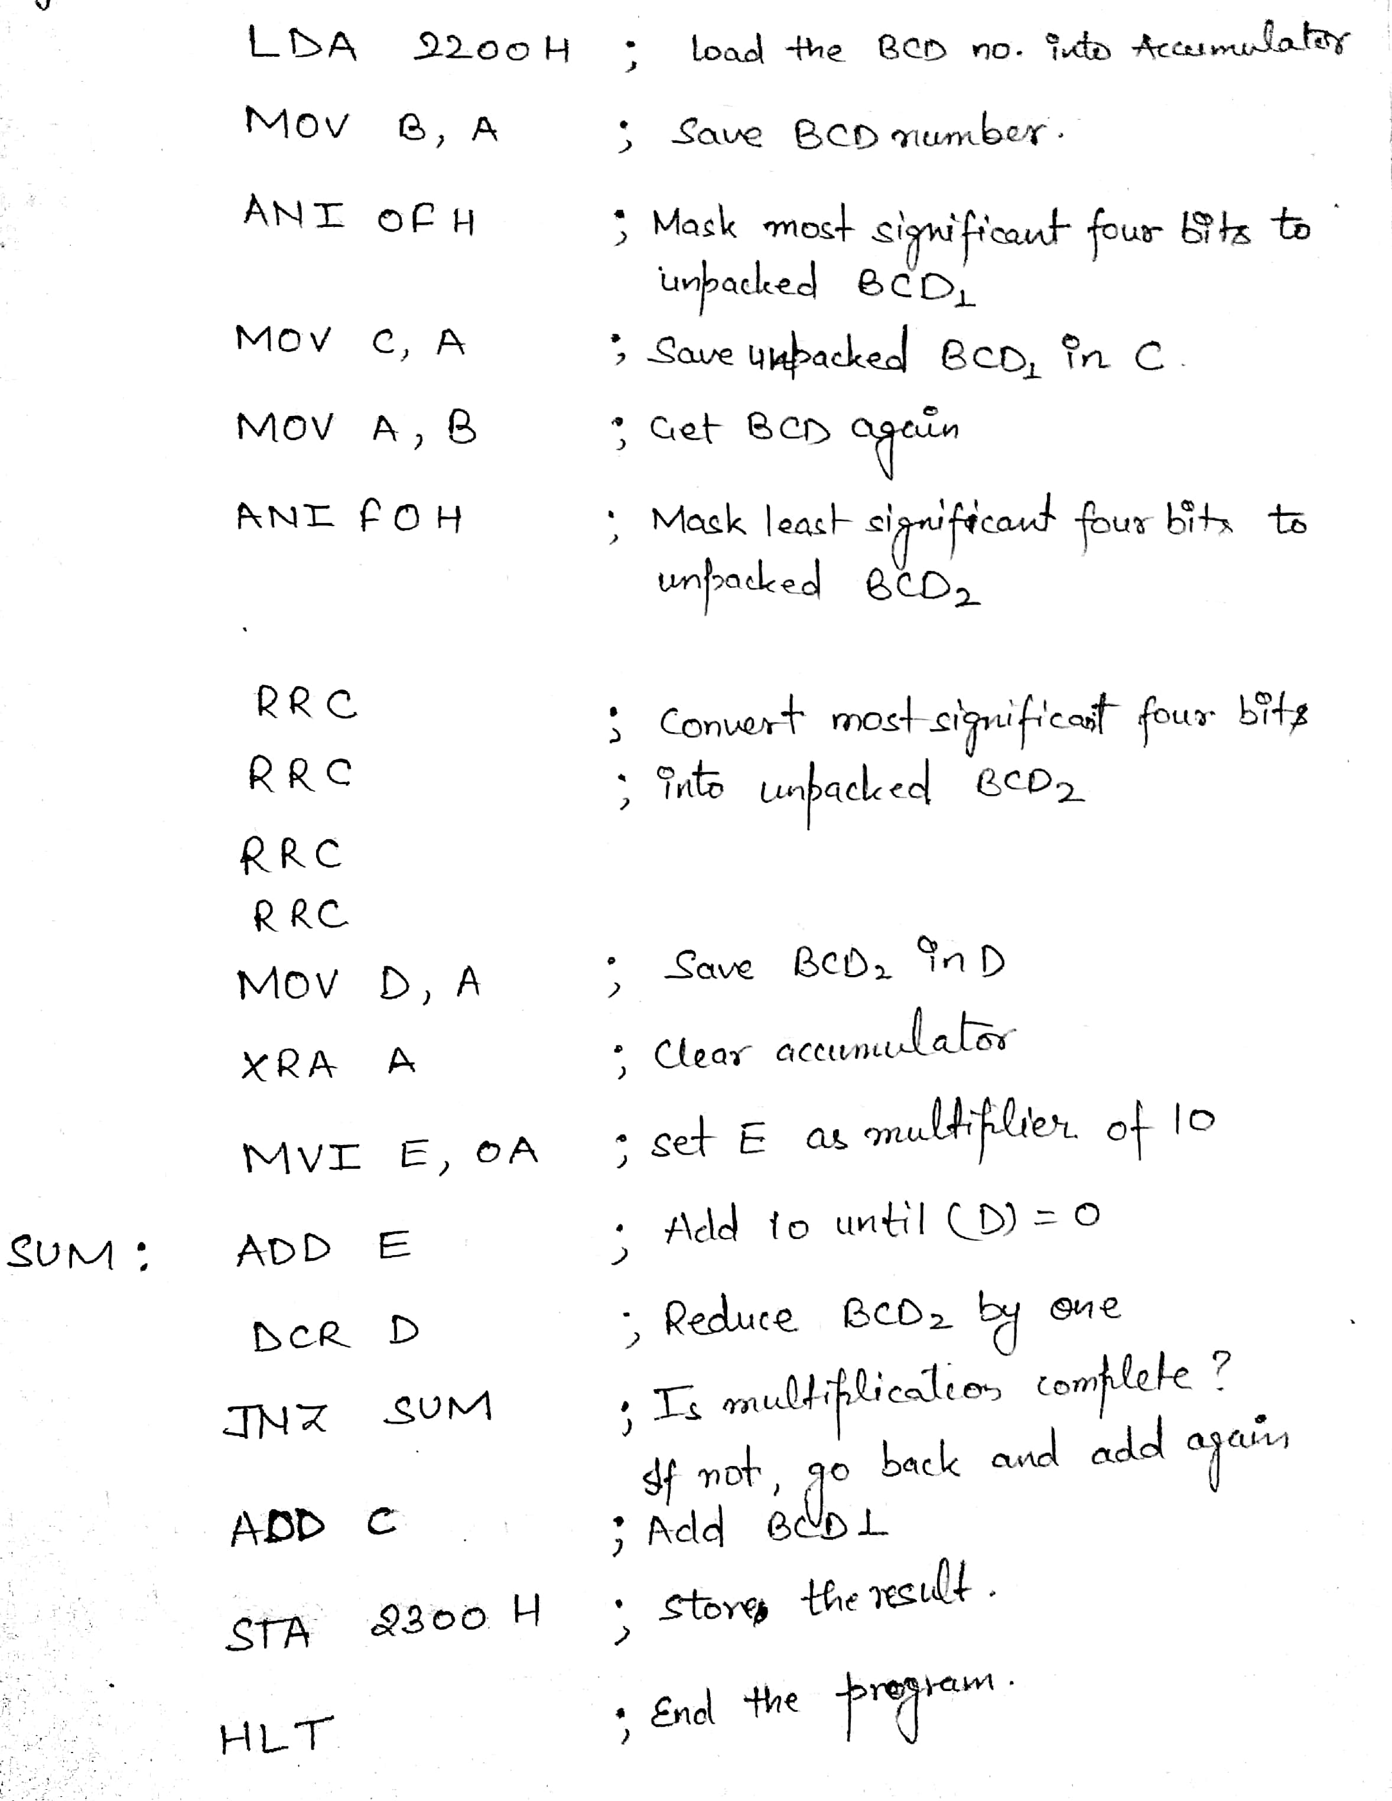
NOIDA INSTITUTE OF ENGINEERING AND TECHNOLOGY, GREATER NOIDA
BCD To Binary Conversion

Slide 66
NOIDA INSTITUTE OF ENGINEERING AND TECHNOLOGY, GREATER NOIDA
Binary to BCD Conversion
Microprocessor-based products, numbers are displayed in decimal. However, if data processing inside the microprocessor is performed in binary, it is necessary to convert the binary results into their equivalent BCD numbers just before they are displayed.
Results are quite often stored in R/W memory locations called the Output Buffer.
The conversion of binary to BCD is performed by dividing the number by the powers of ten and the division is performed by the subtraction method.
For example
1111 11112 (FFH) = 25510
To represent this number in BCD requires twelve bits or three BCD digits, labelled here as BCD3 (MSB), BCD₂, and BCD1 (LSB),
= 0010 0101 0101
BCD3 BCD₂ BCD₁
The conversion can be performed as follows:
Step 1: If the number is less than 100, go to Step 2; otherwise, divide by 100 or subtract 100 repeatedly until the remainder is less than 100. The quotient is the most significant BCD digit BCD₁.
Step 2: If the number is less than 10, go to Step 3, otherwise divide by 10 repeatedly until the remainder is less than 10. The quotient is BCD₂.
Step 3: The remainder from step 2 is BCD₁.

Slide 67
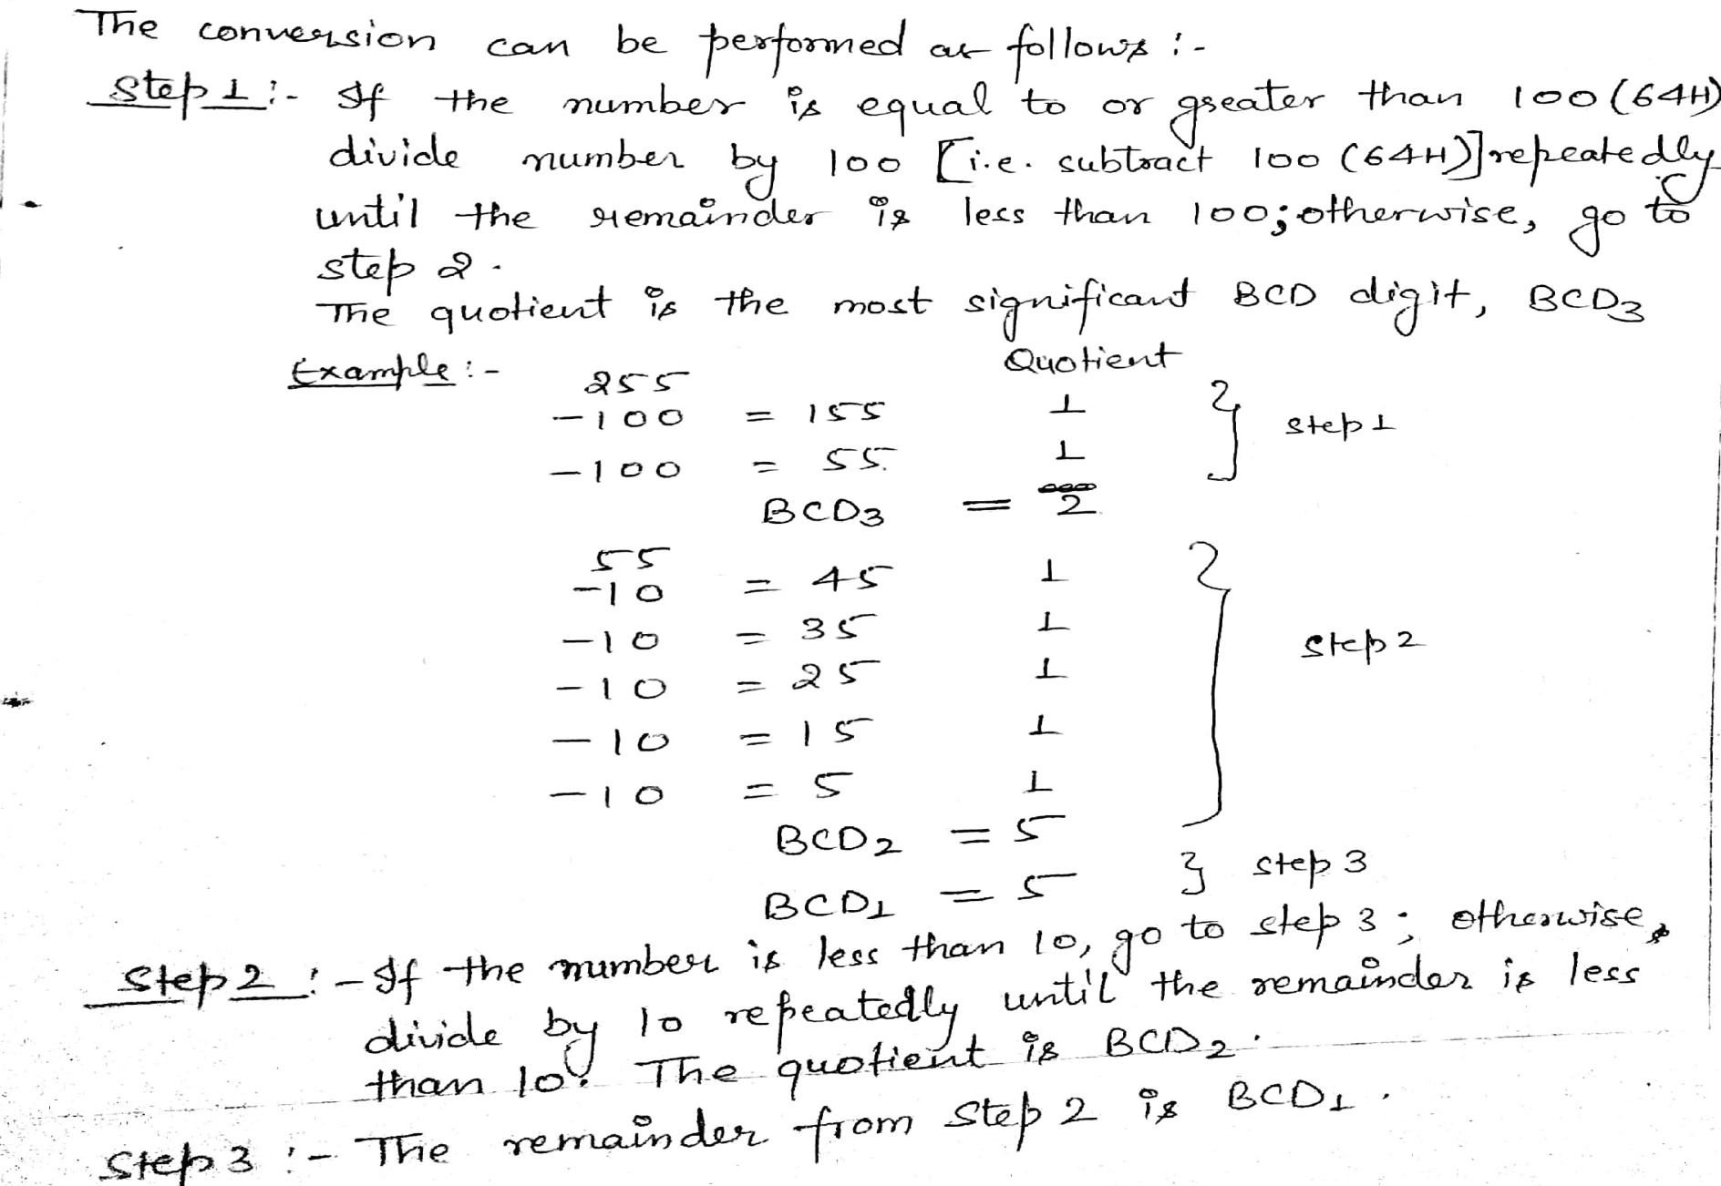
NOIDA INSTITUTE OF ENGINEERING AND TECHNOLOGY, GREATER NOIDA
Binary to BCD Conversion

Slide 68
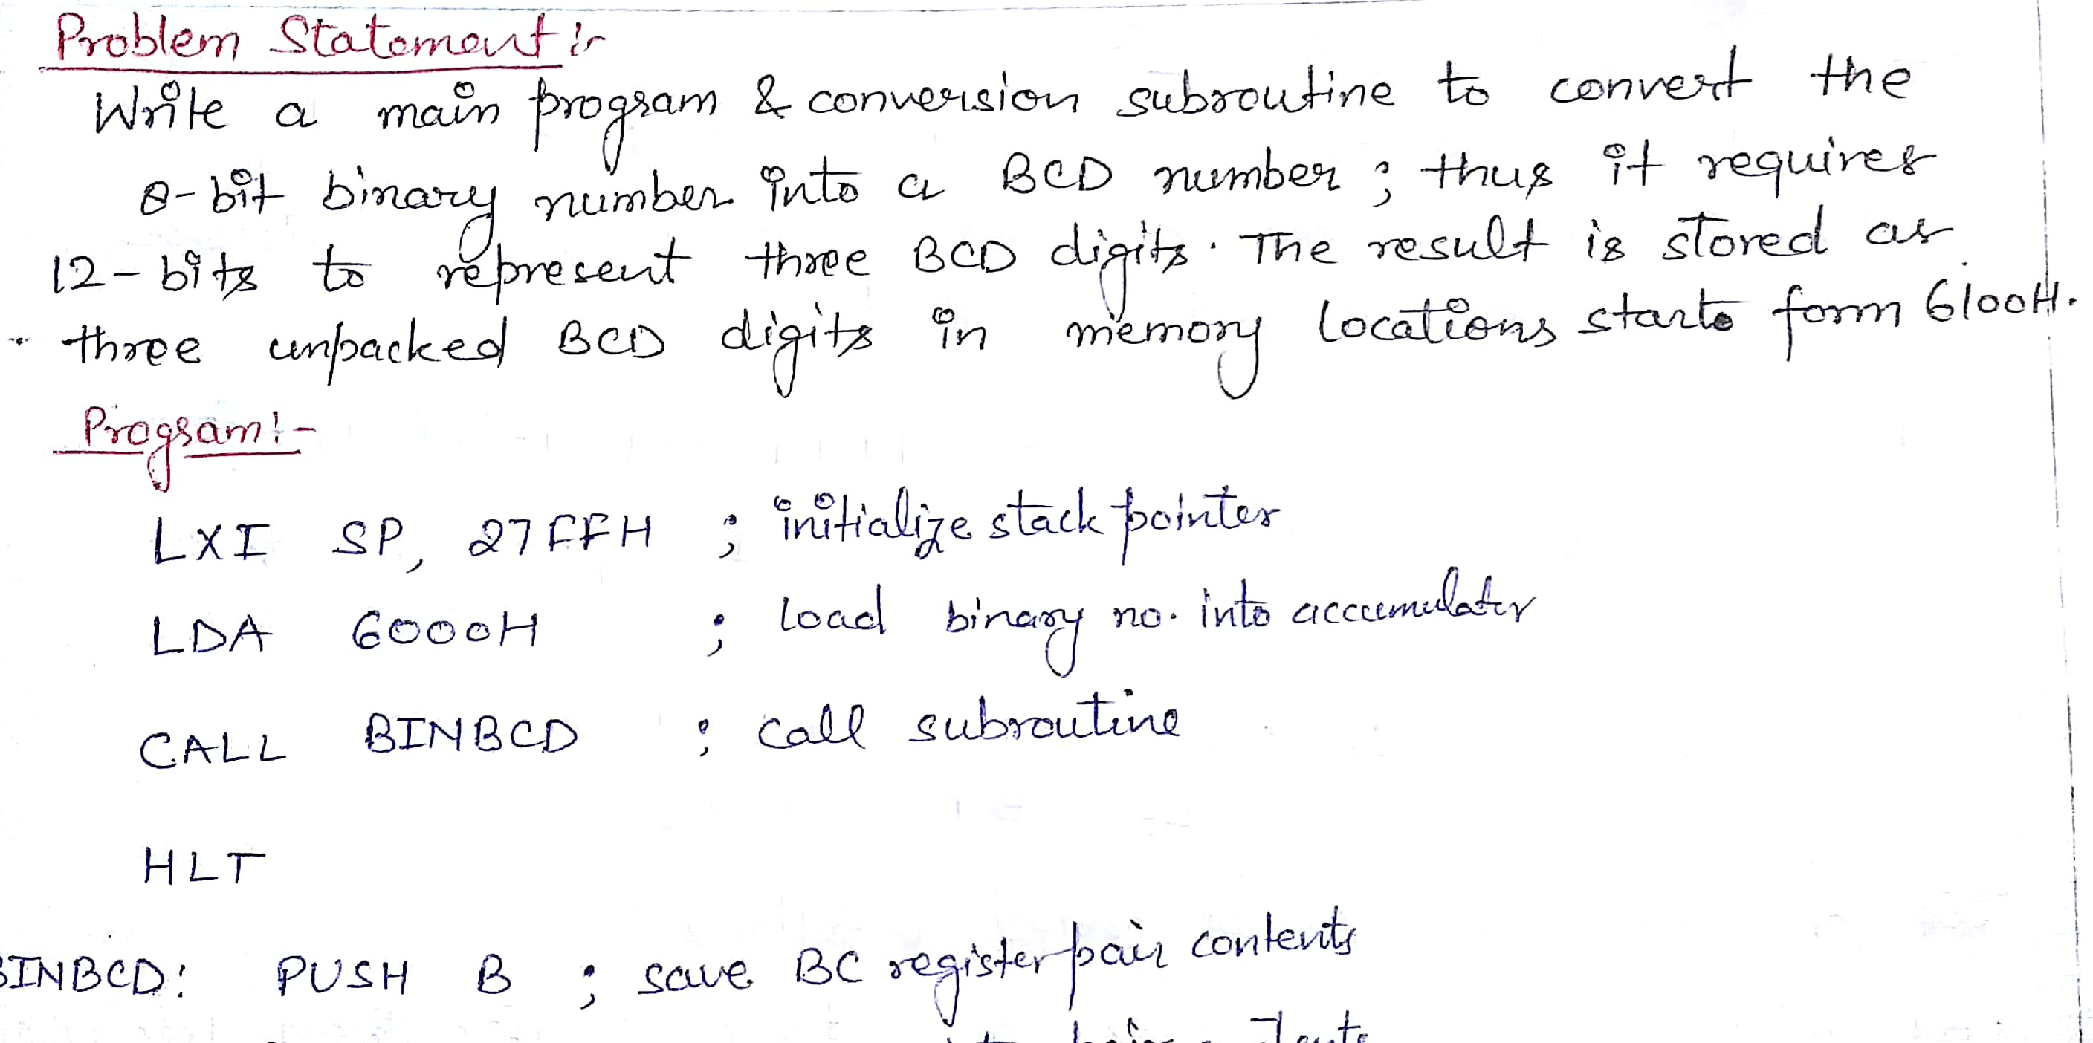
NOIDA INSTITUTE OF ENGINEERING AND TECHNOLOGY, GREATER NOIDA
Binary to BCD Conversion

Slide 69
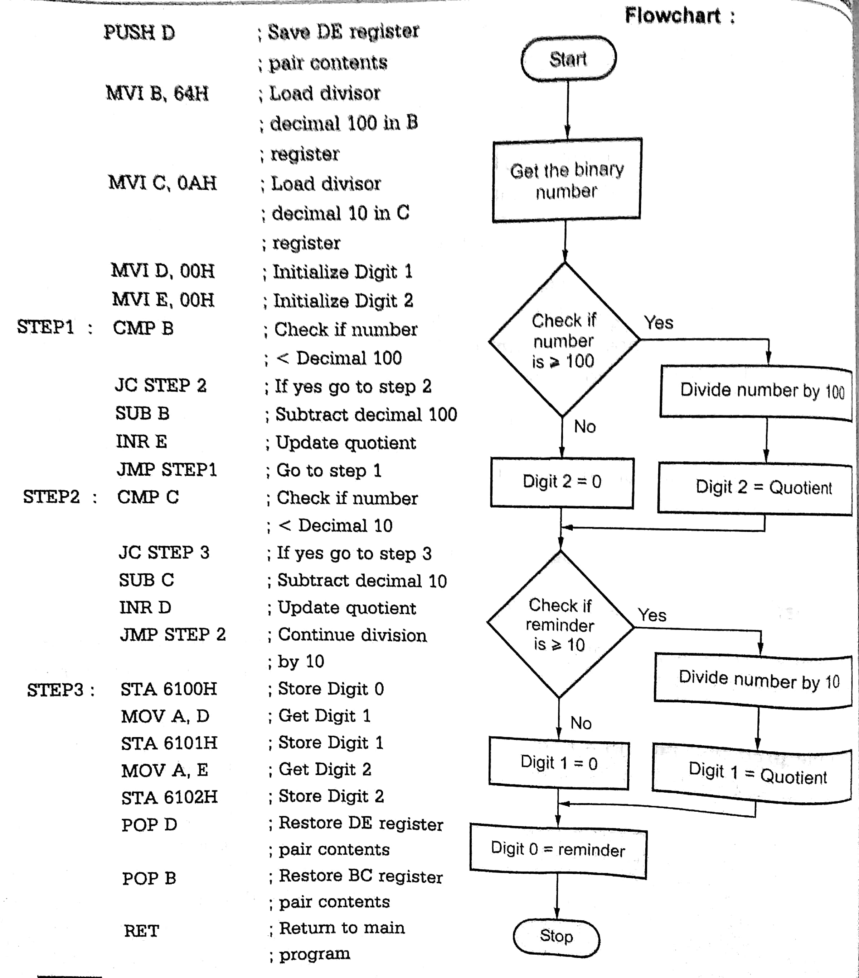
NOIDA INSTITUTE OF ENGINEERING AND TECHNOLOGY, GREATER NOIDA
Binary to BCD Conversion

Slide 70
NOIDA INSTITUTE OF ENGINEERING AND TECHNOLOGY, GREATER NOIDA
BCD to Seven Segment Conversion
Many times 7-segment LED display is used to display the results or parameters in the microprocessor system.
In such cases we have to convert the result or parameter in 7-segment code.
This conversion can be done using look-up technique.
In the look-up table the codes of the digits (0-9) to be displayed are stored sequentially in the memory.
The conversion program locates the code of a digit based on its BCD digit.
Let us see the Program for BCD to common cathode 7-segment code conversion.

Slide 71
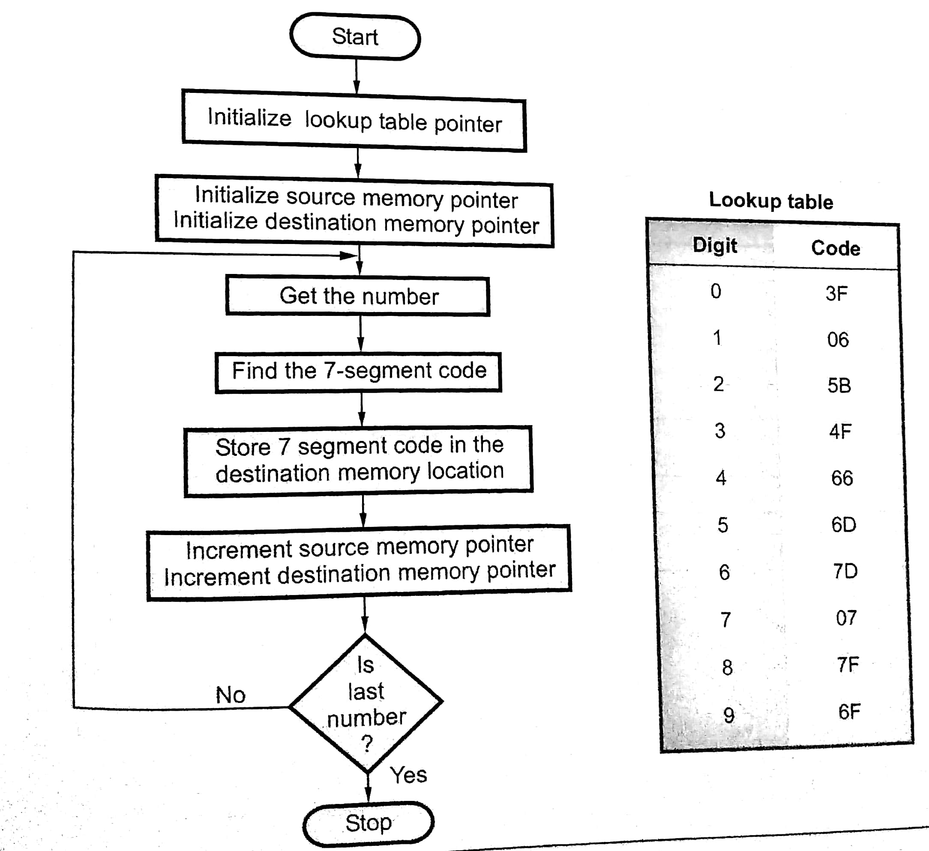
NOIDA INSTITUTE OF ENGINEERING AND TECHNOLOGY, GREATER NOIDA
BCD to Seven Segment Conversion

Slide 72
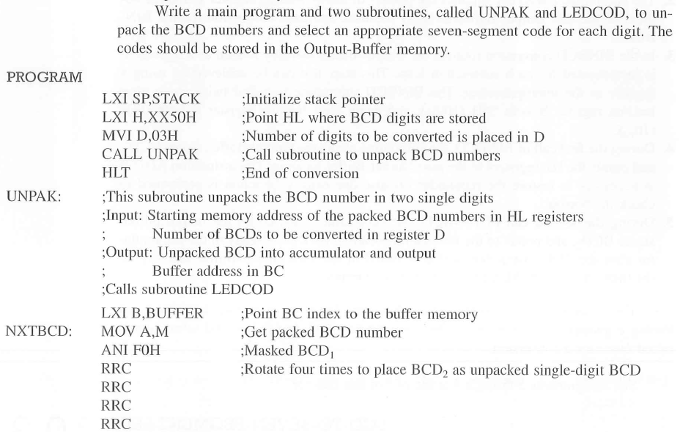
NOIDA INSTITUTE OF ENGINEERING AND TECHNOLOGY, GREATER NOIDA
BCD to Seven Segment Conversion

Slide 73
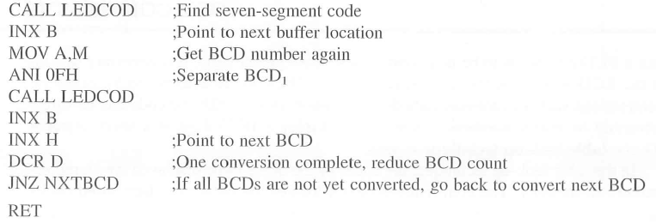
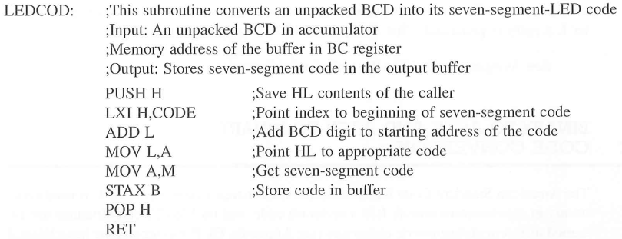
NOIDA INSTITUTE OF ENGINEERING AND TECHNOLOGY, GREATER NOIDA
BCD to Seven Segment Conversion

Slide 74
NOIDA INSTITUTE OF ENGINEERING AND TECHNOLOGY, GREATER NOIDA
Binary to ASCII Code Conversion
The ASCII Code (American Standard Code for Information Interchange) is commonly used for communication.
In such cases we need to convert binary number to its ASCII equivalent.
It is a seven bit code.
In this code number 0 through 9 are represented as 30 through 39 respectively and letters A through Z are represented as 41H through 5AH.
Therefore, by adding 30H we can convert number into its ASCII equivalent and by adding 37H we can convert letter to its ASCII equivalent.
Let us see the Program for binary to ASCII code conversion.

Slide 75
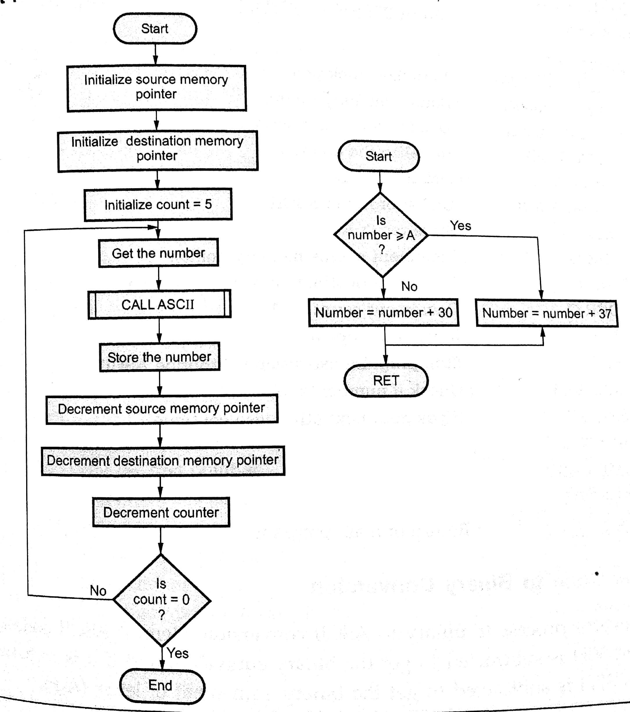
NOIDA INSTITUTE OF ENGINEERING AND TECHNOLOGY, GREATER NOIDA
Binary to ASCII Code Conversion

Slide 76
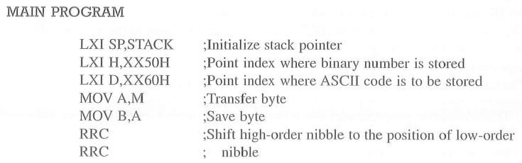
NOIDA INSTITUTE OF ENGINEERING AND TECHNOLOGY, GREATER NOIDA
Binary to ASCII Code Conversion

Slide 77
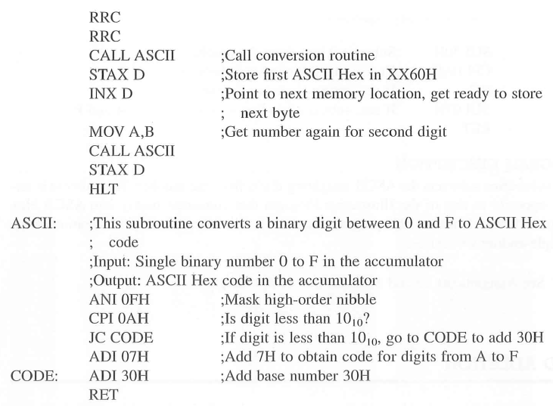
NOIDA INSTITUTE OF ENGINEERING AND TECHNOLOGY, GREATER NOIDA
Binary to ASCII Code Conversion

Slide 78
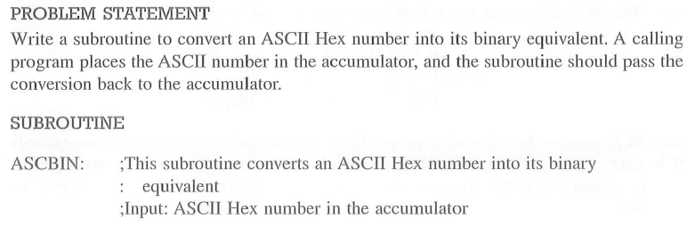
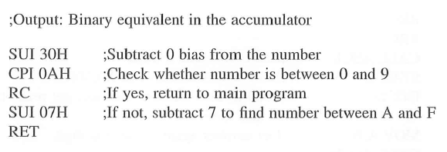
NOIDA INSTITUTE OF ENGINEERING AND TECHNOLOGY, GREATER NOIDA
ASCII Code to Binary Conversion

Slide 79
NOIDA INSTITUTE OF ENGINEERING AND TECHNOLOGY, GREATER NOIDA
BCD Addition
The microprocessor cannot recognize BCD numbers; it adds any two numbers in binary. In BCD addition, any number larger than 9 (from A to F) is invalid and needs to be adjusted by adding 6 in binary.
E.g. A: 0000 1010
+ 0000 0110
0001 0000 10 BCD
A special instruction called DAA performs the function of adjusting a BCD sum in 8085. It uses the AC flag to sense that the value of the least four bits is larger than 9 and adjusts the bits to BCD value. Similarly, it uses CY flag to adjust the most significant four bits.
E.g. Add BCD 77 and 48
77 = 0111 0111
+48 = 0100 1000
125 = 1011 1111
+0110
1 0101
+0110
CY = 0010 0101 25 BCD
1

Slide 80
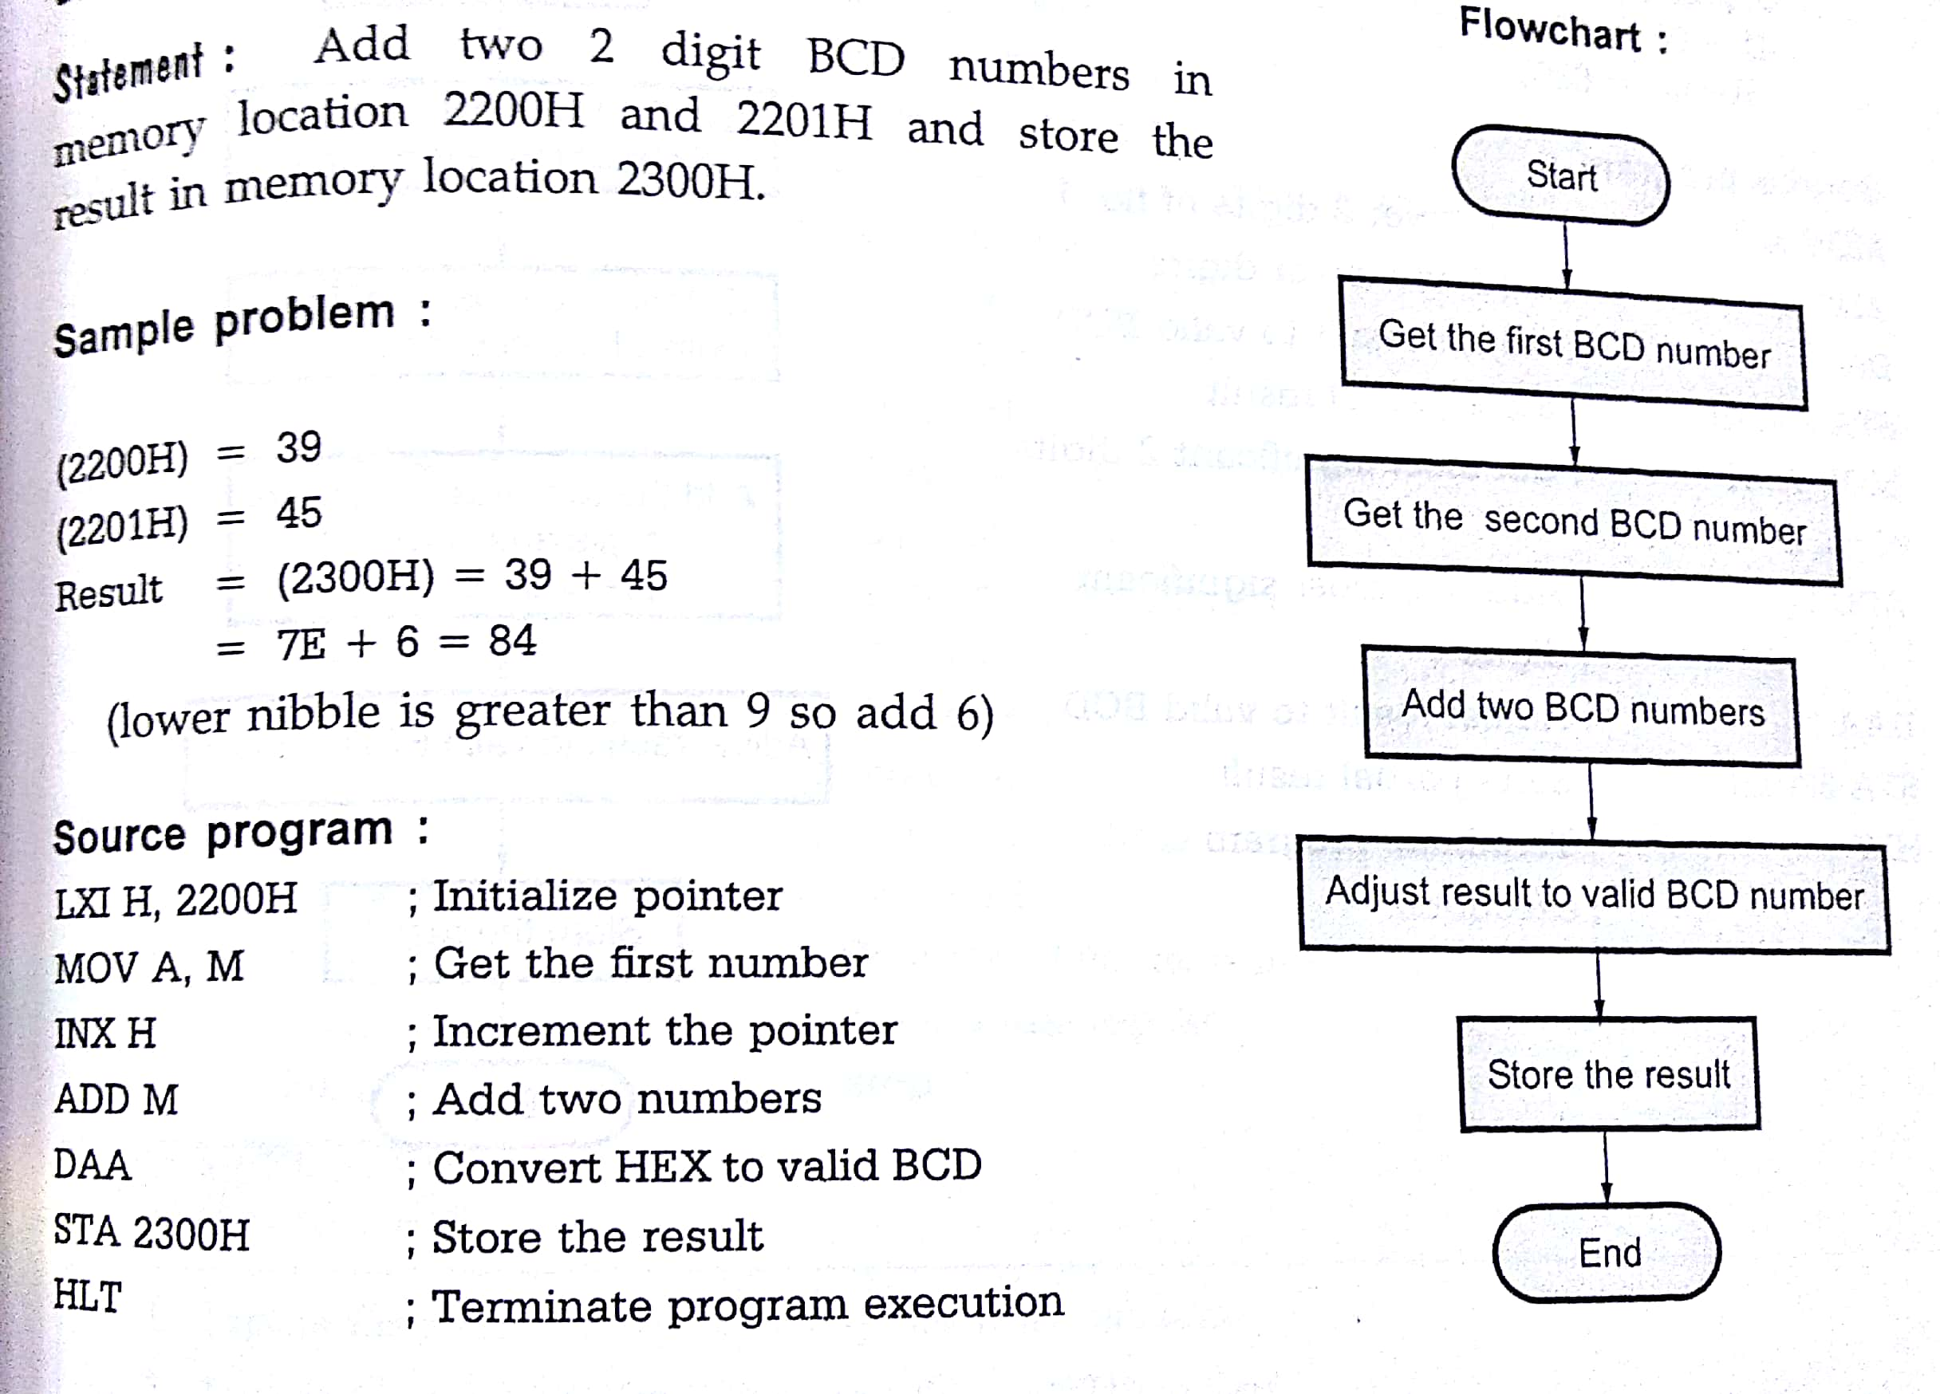
NOIDA INSTITUTE OF ENGINEERING AND TECHNOLOGY, GREATER NOIDA
BCD Addition (2-digit)

Slide 81
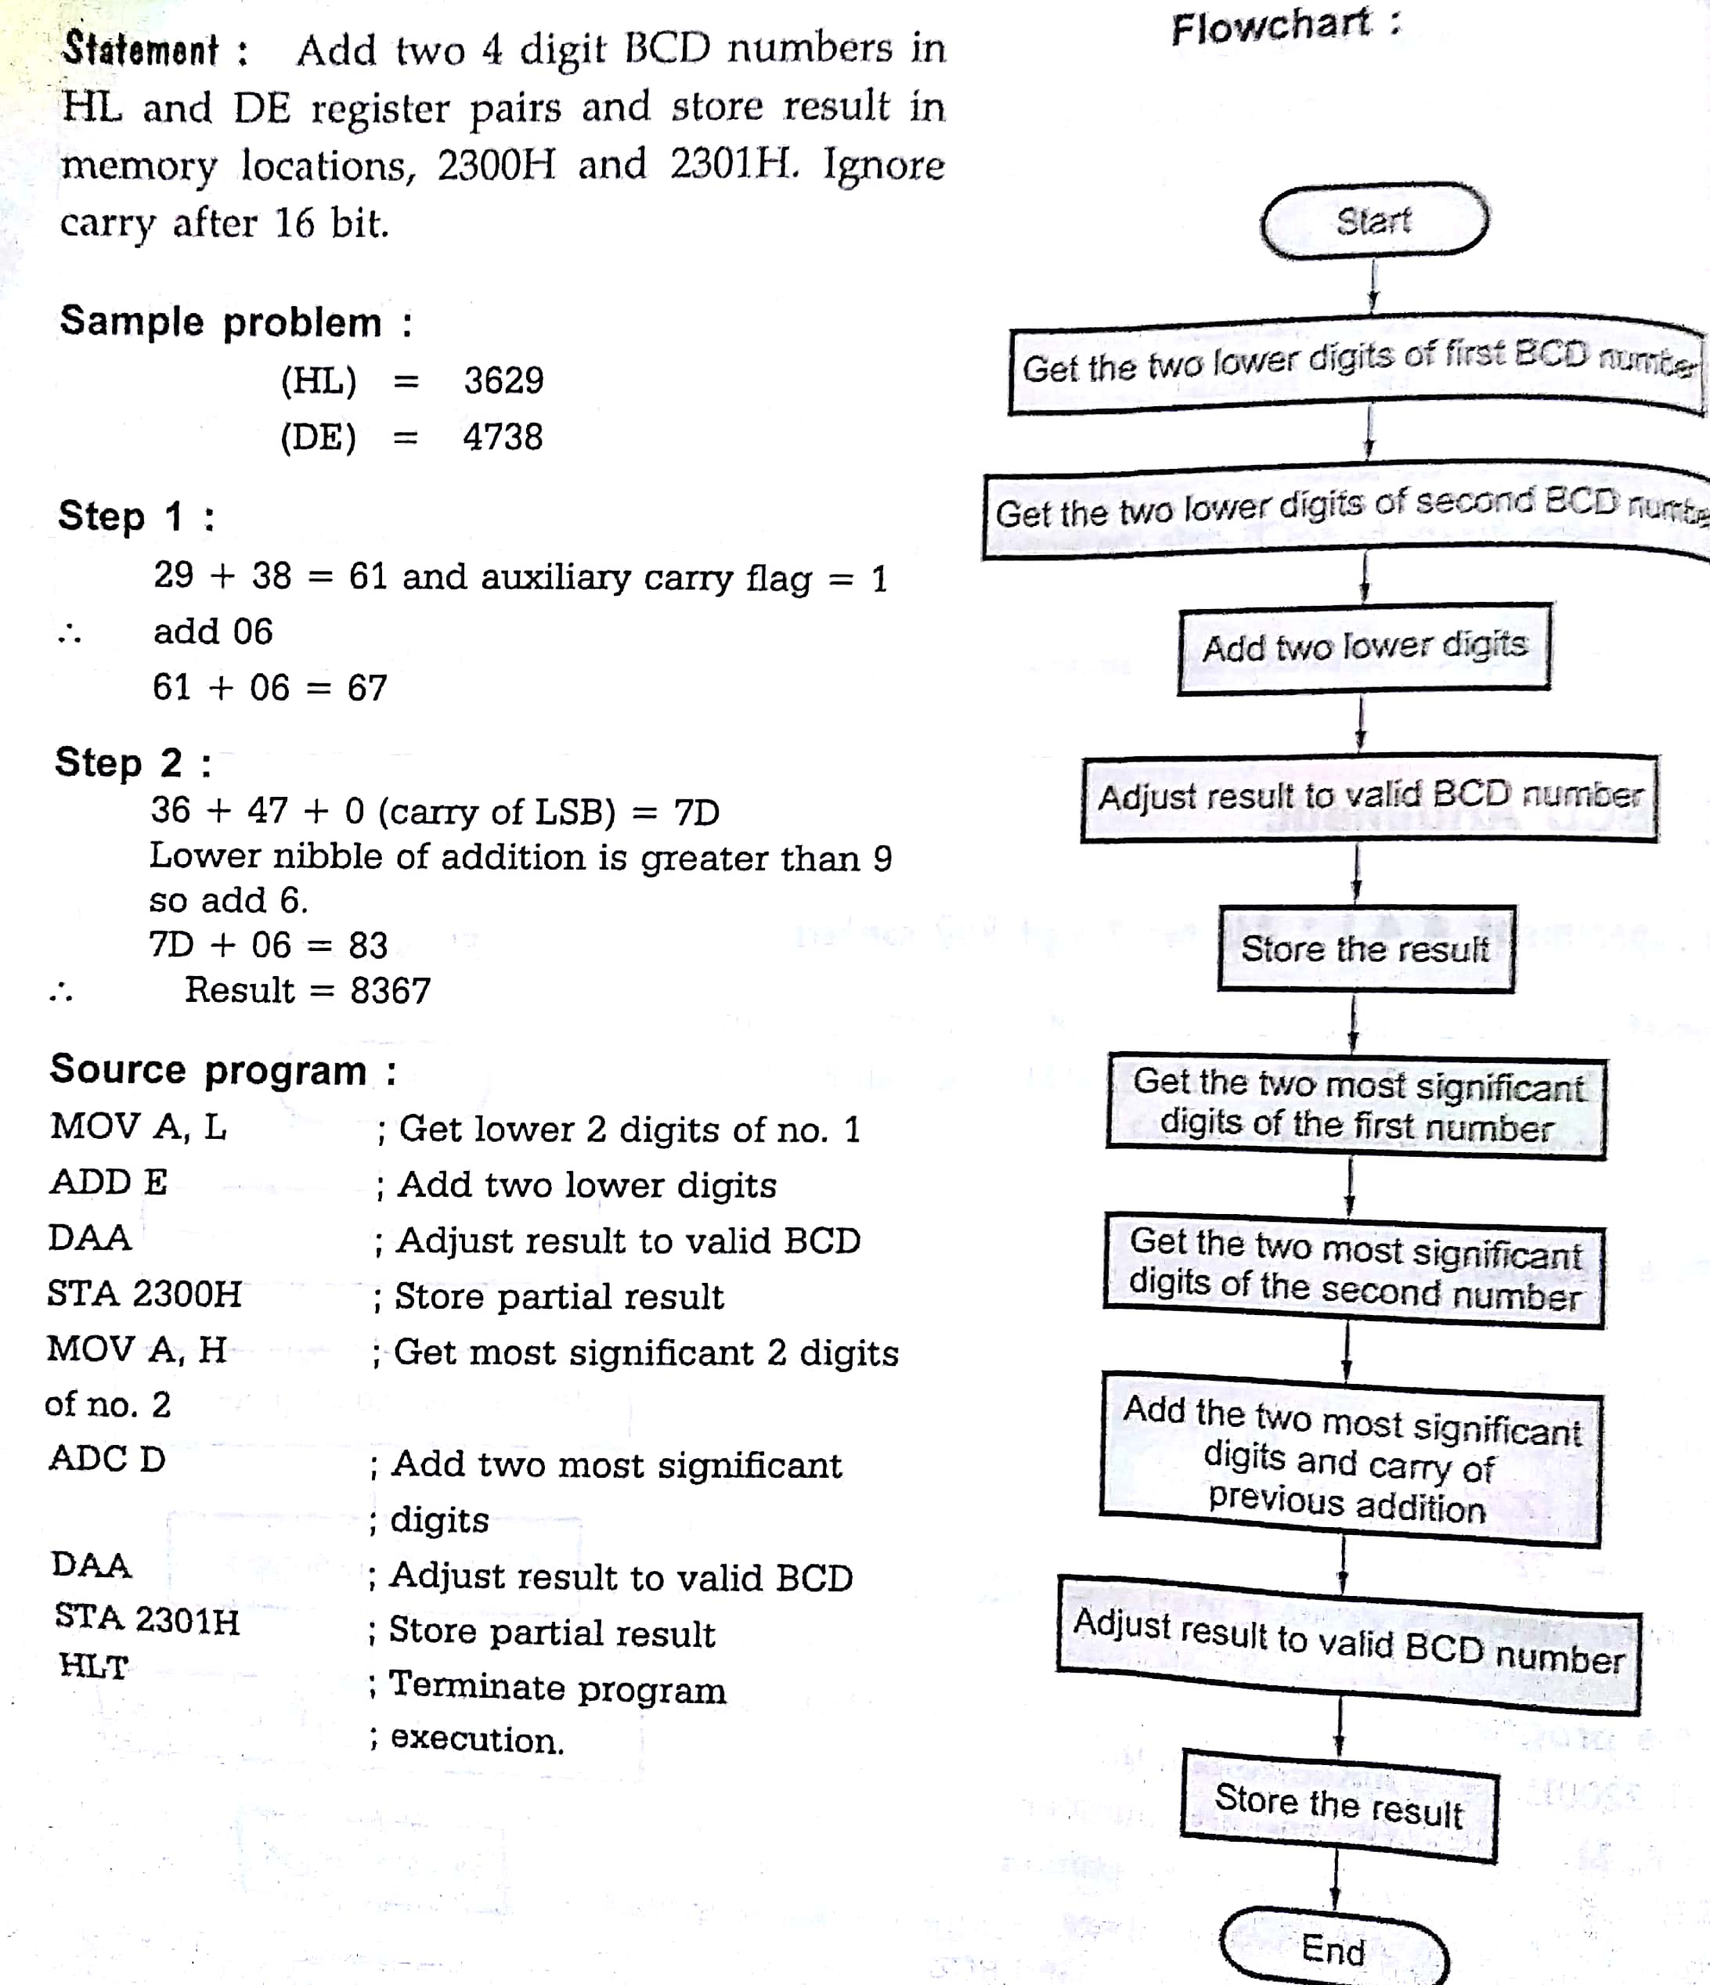
NOIDA INSTITUTE OF ENGINEERING AND TECHNOLOGY, GREATER NOIDA
BCD Addition (4-digit)

Slide 82
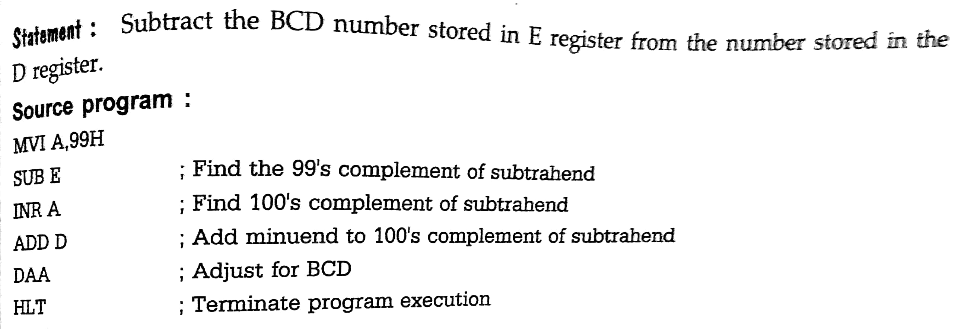
NOIDA INSTITUTE OF ENGINEERING AND TECHNOLOGY, GREATER NOIDA
BCD Subtraction

Slide 83
NOIDA INSTITUTE OF ENGINEERING AND TECHNOLOGY, GREATER NOIDA
BCD Subtraction
8085 performs subtraction operation by using 2’s complement and the steps used are:
1) Converts the subtrahend (the number to be subtracted) into its 1’s complement.
2) Adds 1 to 1’s complement to obtain 2’s complement of the subtrahend.
3) Adds 2’s complement to the minuend (the contents of the accumulator).
4) Complements the carry flag.
E.g. MVI A, 97H 65H: 0 1 1 0 0 1 0 1
MVI B, 65H 1’s complement of 65H : 1 0 0 1 1 0 1 0
SUB B +1
2’s Complement of 65H: 1 0 0 1 1 0 1 1
97H: + 1 0 0 1 0 1 1 1
1 0 0 1 1 0 0 1 0
32
CY
Complement carry = 0 A=32 CY=0

Slide 84
NOIDA INSTITUTE OF ENGINEERING AND TECHNOLOGY, GREATER NOIDA
BCD Subtraction
B=97H, A=65H
97H: 1 0 0 1 0 1 1 1
MVI B, 65H 1’s complement of 97H: 0 1 1 0 1 0 0 0
SUB B +1
2’s Complement of 97H: 0 1 1 0 1 0 0 1
65H: + 0 1 1 0 0 1 0 1
0 1 1 0 0 1 1 1 0
(Result in 2’s complement form)
CY
CY=1, A= CE: 1 1 0 0 1 1 1 1 0
1’s complement: 0 0 1 1 0 0 0 0 1
2’s complement: 0 0 1 1 0 0 0 1 0
32

Slide 85
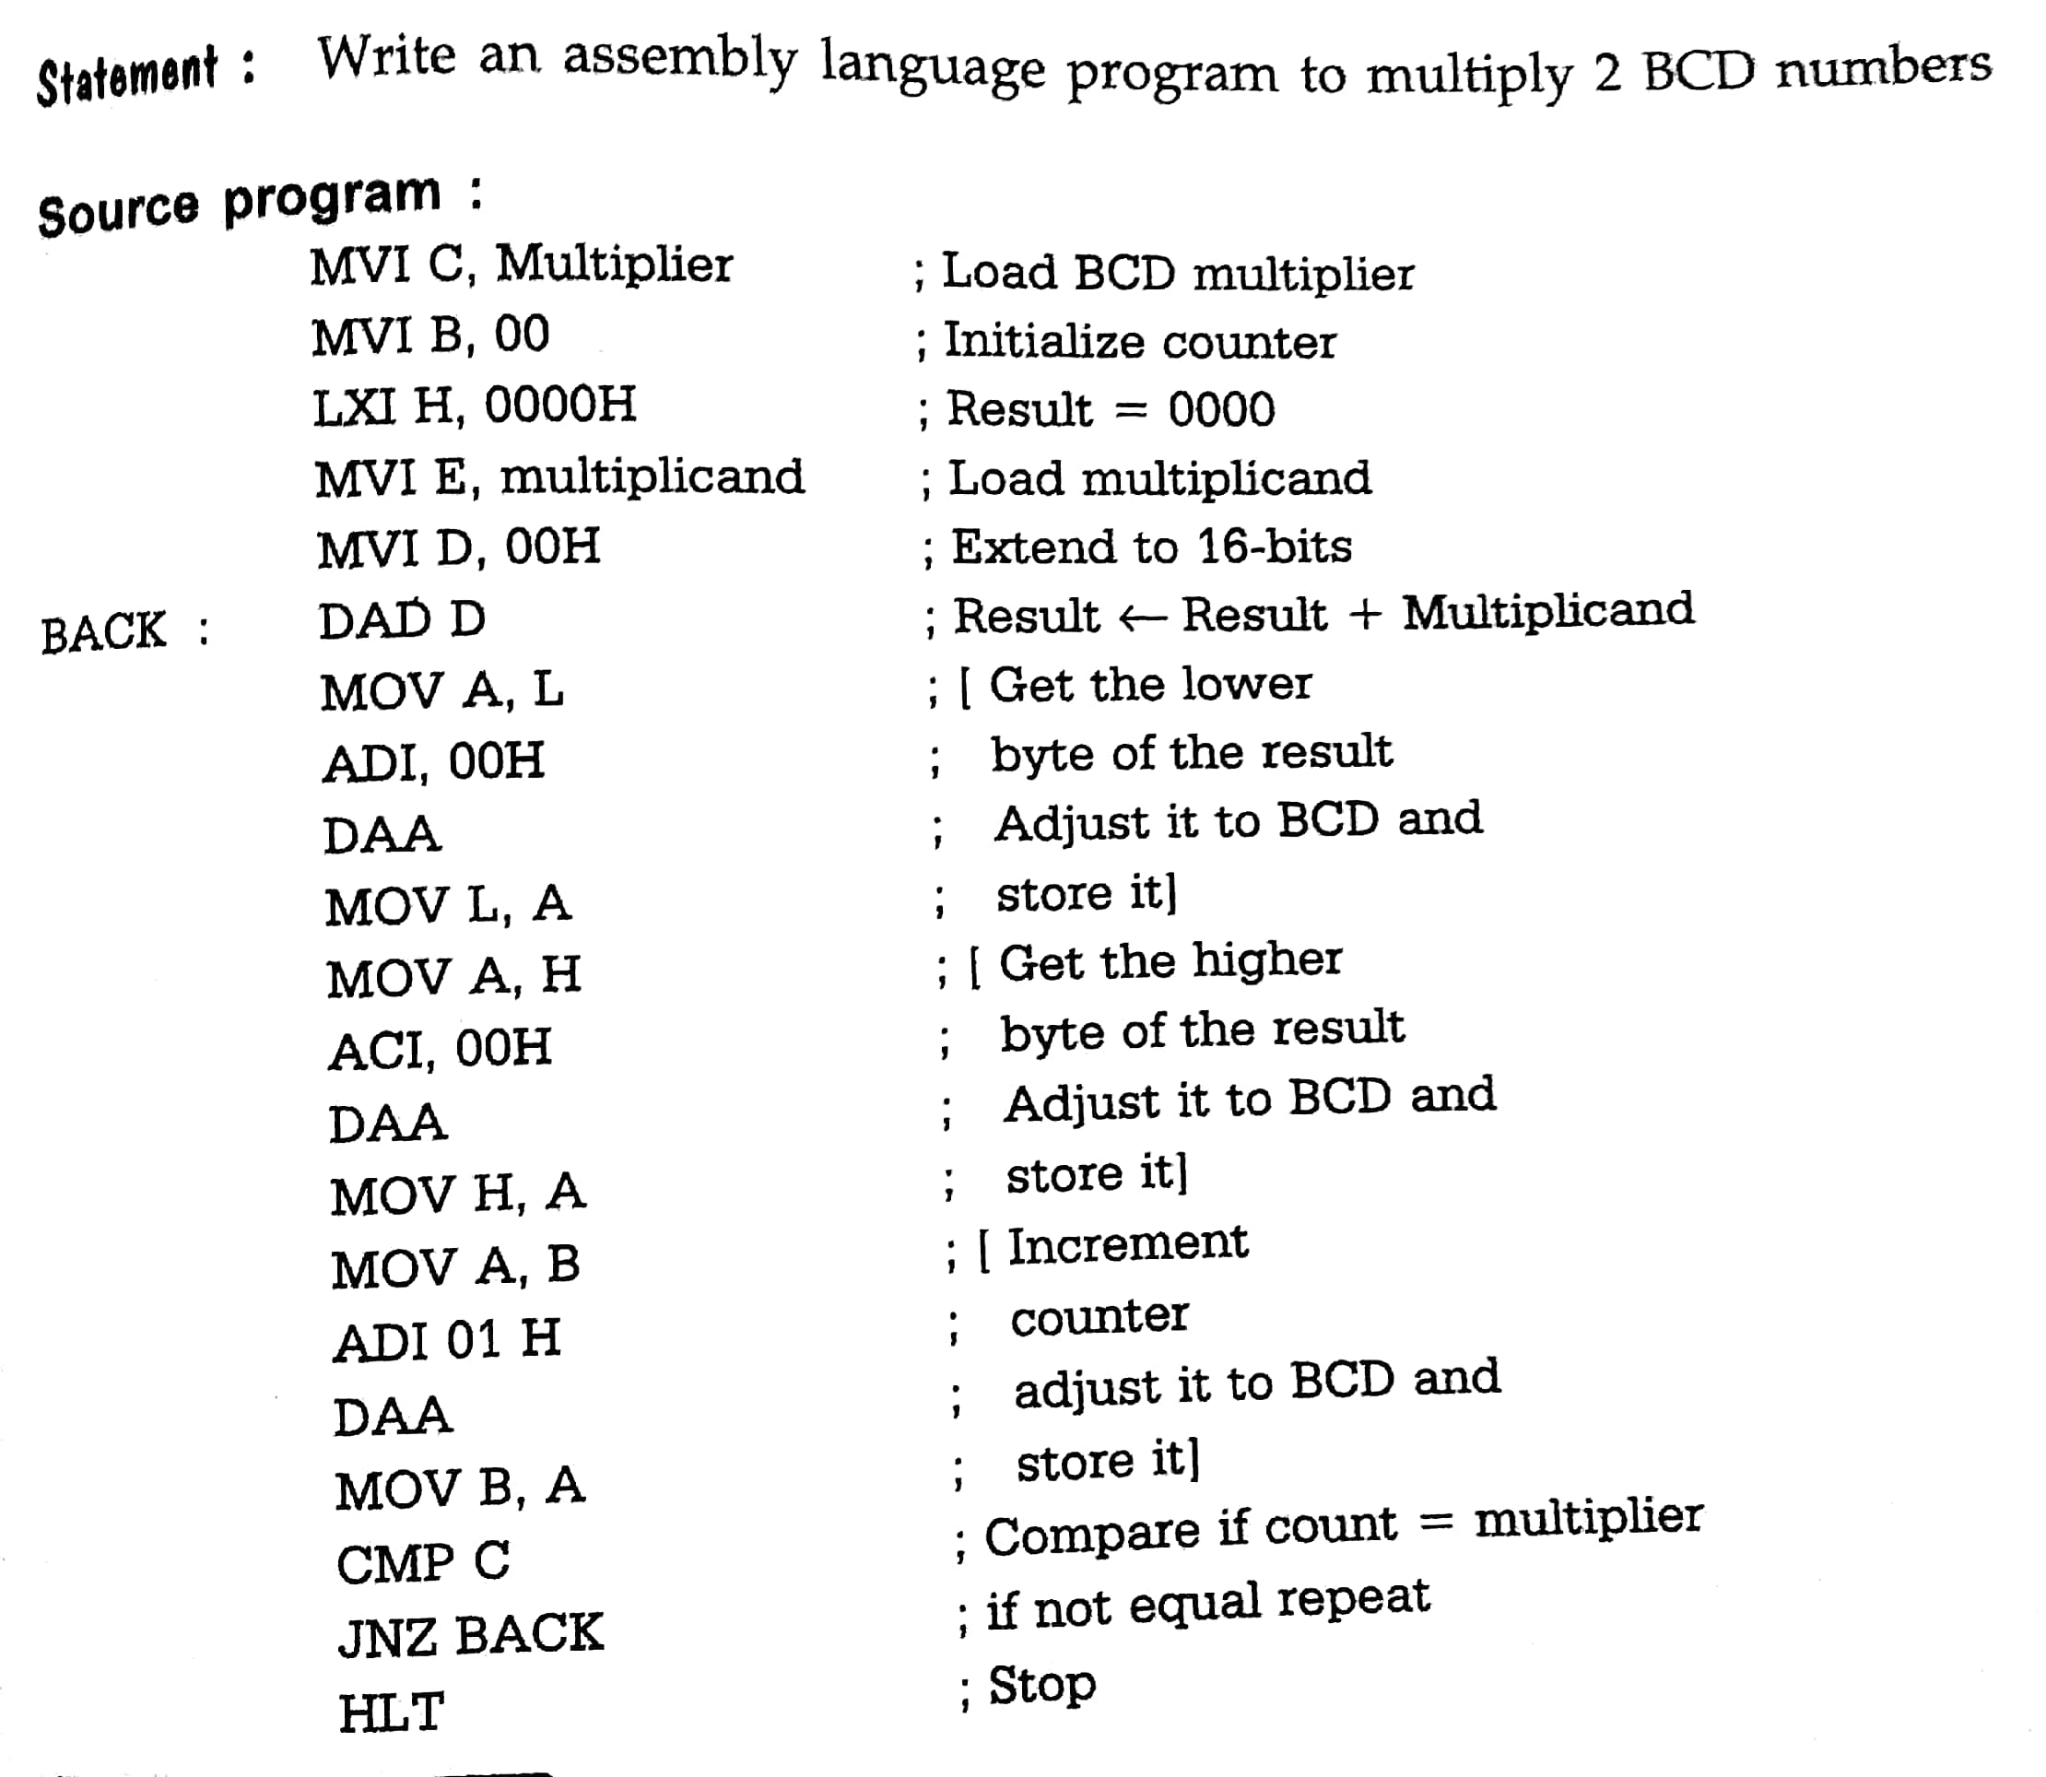
NOIDA INSTITUTE OF ENGINEERING AND TECHNOLOGY, GREATER NOIDA
BCD Multiplication

Slide 86
Daily Quiz
PROM stands for:
Programmable read-only memory
Programmable read write memory
Programmer read and write memory
None of these
The method of connecting a driving device to a loading device is known as ___________ a) Compatibility b) Interface c) Sourcing d) Sinking

Slide 87
Weekly Assignment
1. What do you mean by tri-state devices?
2. With the help of a neat symbol explain tri-state buffer.
3. State function of buffer.
4. Explain different types of encoder.
5. With the help of neat block diagram explain 4 to 2 encoder.
6. What do you mean by priority encoder?
7. With the help of neat block diagram explain 8 to 3 encoder.
8. Explain decoder in detail.
9. With the help of neat block diagram explain 3 to 8 decoder.
10. Explain the working of D flipflop.

Slide 88
Topic Links
https://www.youtube.com/watch?v=_EJDoLnJ5BM
https://www.youtube.com/watch?v=bXOpC0z-8o8

Slide 89
NOIDA INSTITUTE OF ENGINEERING AND TECHNOLOGY, GREATER NOIDA
Faculty Video Links, Youtube & NPTEL Video Links and Online Courses Details
Youtube/other Video Links
https://www.youtube.com/watch?v=xBYhHC8_A6o
https://www.youtube.com/watch?v=Xi_jRzyq42g
https://www.youtube.com/watch?v=Xi_jRzyq42g

Slide 90
MCQ s
1)Single Flip-Flop can store ____ bits of information.
2)Which of the following components present in a computer?
A. CPU, Memory
B. Peripherals
C. Both a &amp; b
D. None of the above
3)Program counter(PC) contains?
A. Address of the current instruction
B. Address of the next instruction to fetch
C. Value of the operand
D. starting address of the program

Slide 91
MCQ s
4)Instruction decoder
A. Holds the address of the current instruction
B. Contains next instruction to be fetch
C. Decodes the OPCODE and generates control
signals
D. Fetches operands from memory
5)Decimal equivalent of(F4C) 16 is________________
6)ALU stands for
A. Arithmetic Logic Unit
B. Arithmetic Lower unit
C. Addition Logic Unit
D. AND Logic Unit

Slide 92
MCQ s
7)Which of the following sequence of operation conforms to an instruction cycle?
A. Fetch, Execute, Decode
B. Execute, Fetch, Decode
C. Fetch, Decode, Execute
D. Decode, Fetch, Execute
8)What is the high speed memory between the main memory and CPU called?
A. Magnetic Disk
B. Cache memory
C. DRAM
D. Secondary memory

Slide 93
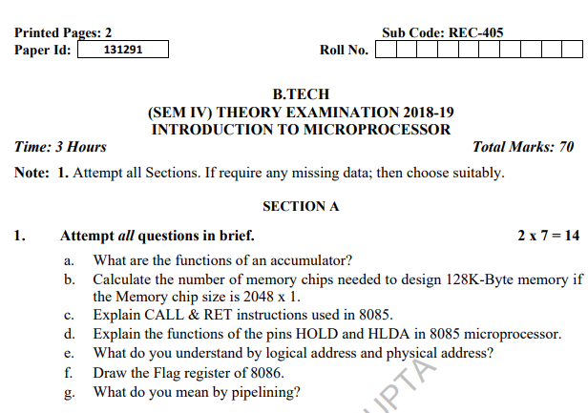
Old Question Papers

Slide 94
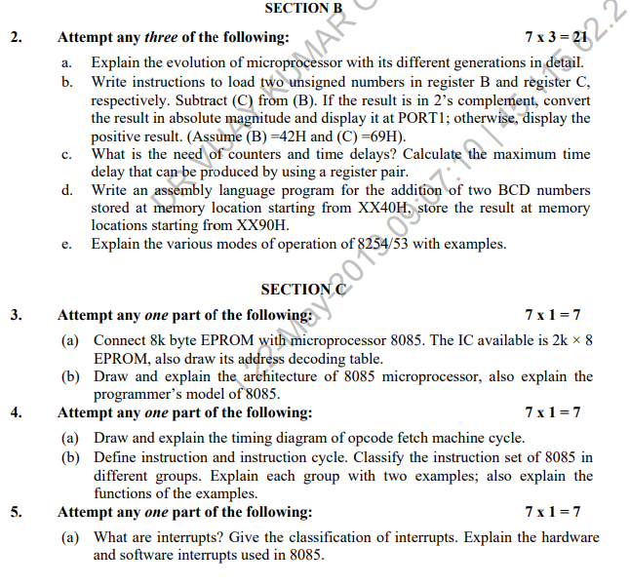
Old Question Papers

Slide 95
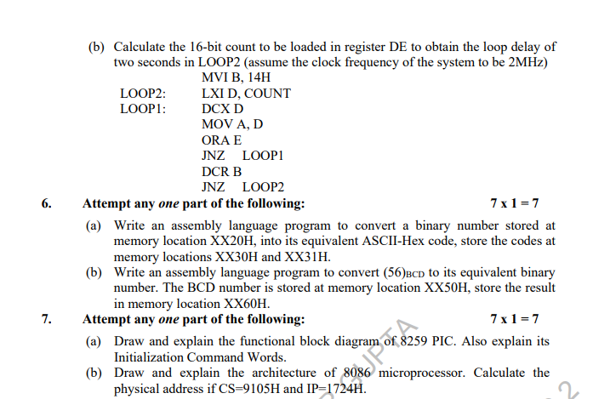
Old Question Papers

Slide 96
Expected Questions for University Exam
A processor has the size of its Read Only Memory (ROM) to be 8KB. If ROM chips of size 1Kb is only available, how many such chips are required to realize the ROM of the processor? Also, what is the minimum number of address lines required to realize the ROM? (Notation: b – bit, B – Byte)
If the crystal frequency is 10 MHz, how much time is required to execute an instruction of 18-T states?
If the 8085 adds 87H and 79H, specify the contents of the accumulator and status flags.
Discuss the various logic devices used in interfacing circuits.
Differentiate between microprocessor, micro-computer and microcontroller. What are the various operations performed by microprocessor?

Slide 97
Summary
Differences between:
Microcomputer – a computer with a microprocessor as its CPU. Includes memory, I/O etc.
Microprocessor – silicon chip which includes ALU, register circuits & control circuits
Microcontroller – silicon chip which includes microprocessor, memory & I/O in a single package.

Slide 98
References
Text Book:
– Ramesh S. Goankar, “Microprocessor Architecture, Programming and Applications with 8085”, 5th Edition, Prentice Hall

Slide 99
ANY QUERIES?
Thank You

